Slide 1


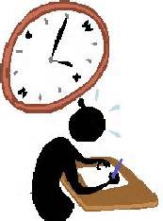

A helping hand from the Social science department

Slide 2
Key dates for your diary
Exams
The course is 100 % exam and there are 2 papers.
Paper 1- Friday 10th May (PM)
Paper 2- Tuesday 21st May (PM)
We are very fortunate and unique in the sense that the students finish learning the specification by Feb half term so the remainder of the year will be dedicated to revision. It is essential that this time is used to full effect and supported with work at home too.
Aside from this point there are a few key dates.
Intervention sessions
Certain students will be invited and these will run once a week
Revision lectures are:
All students will be invited to 2 sessions one shortly before each exam Dates for this TBC

Slide 3
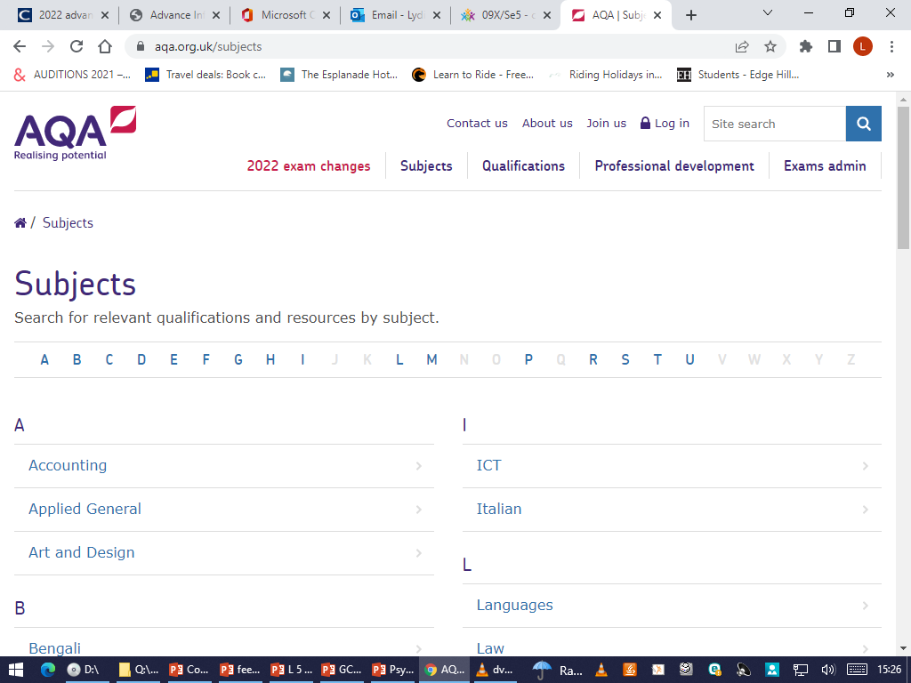
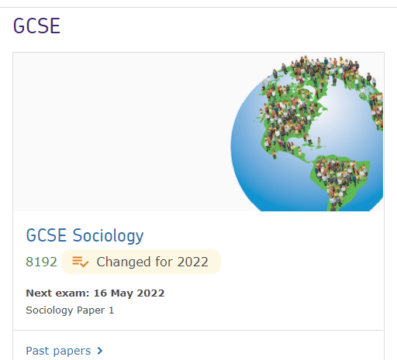
Things you can do to help
Practise, practise, practise.
The best way to revise is once your son/daughter has reviewed a topic, they should then have a go at the examination questions provided in the GCSE revision workbook.
They can also access past questions.
1. Go to http://www.AQA.org.uk/
Select Subjects
then Sociology
Select GCSE
Then Sociology 8192
Then select past papers, mark schemes
and reports.

Slide 4
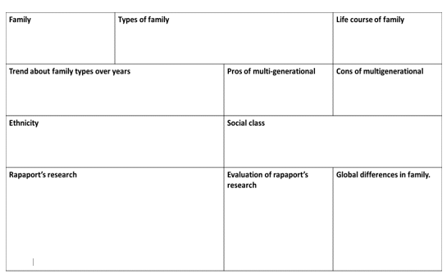
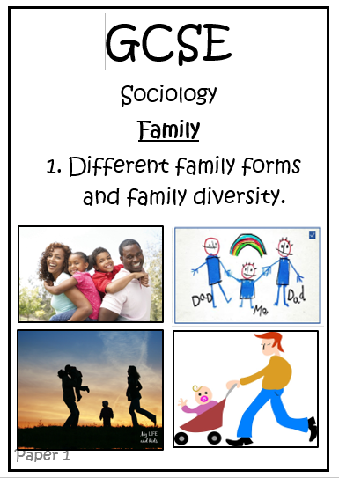
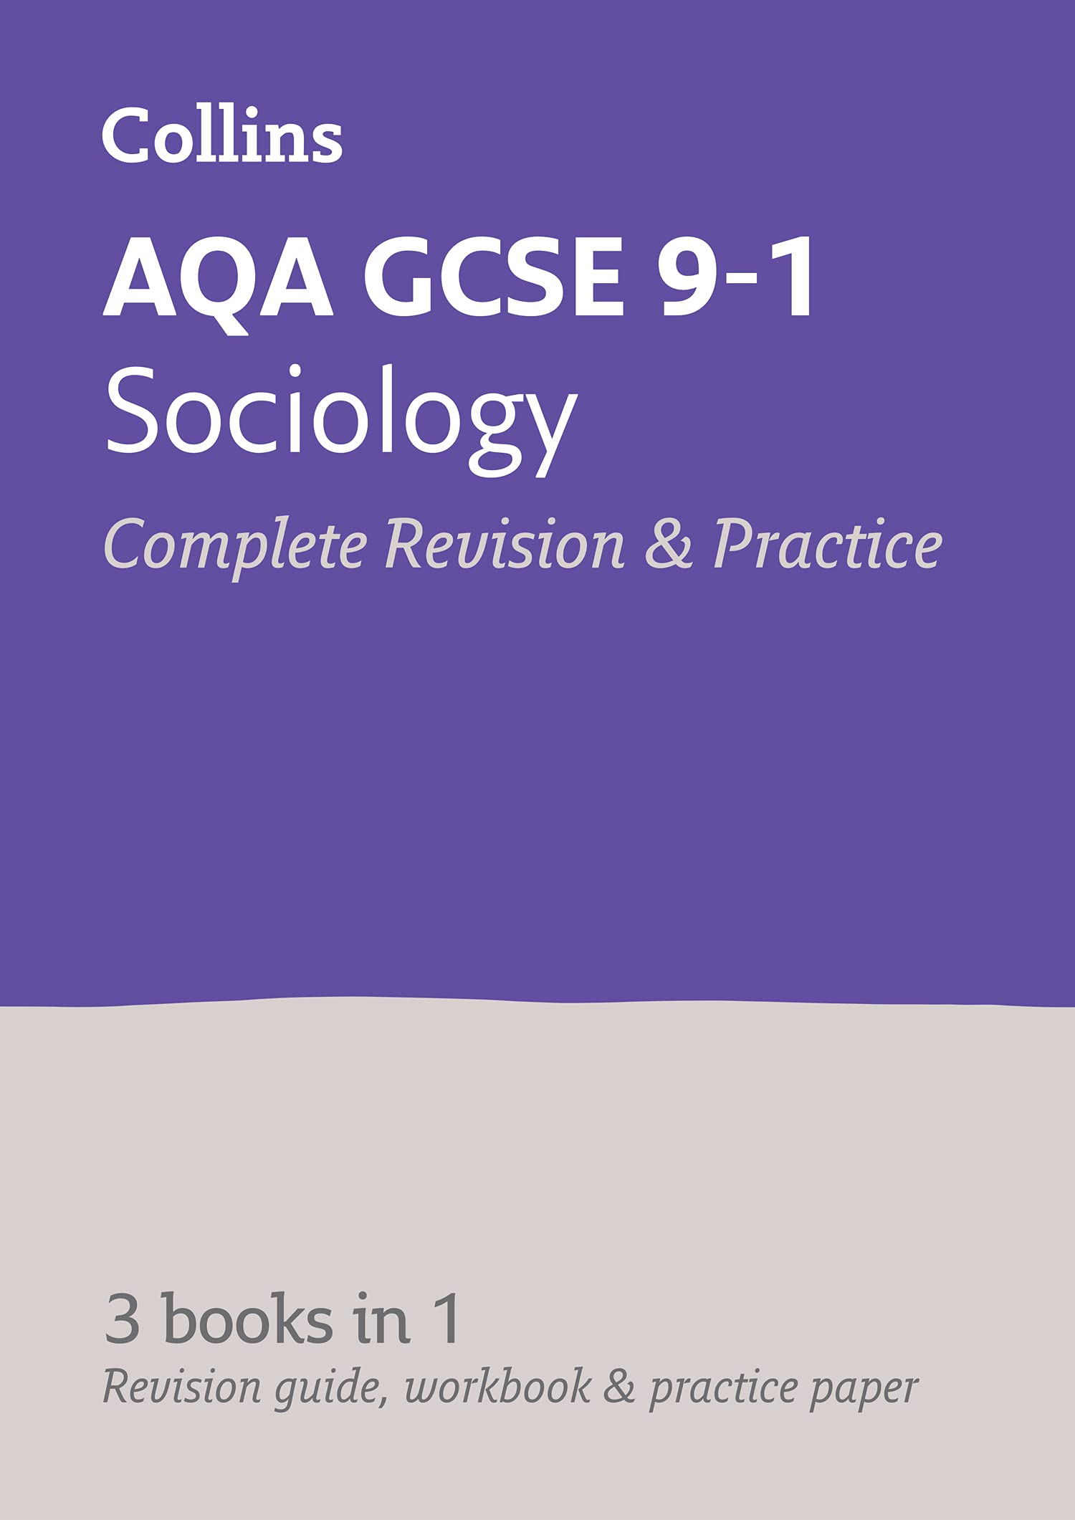
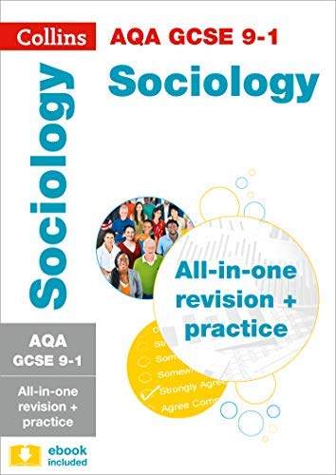
Other resources your sons and daughters will have
They obviously should have their original content booklets for each topic area in their folders also.
They will have revision mindmaps for all 4 topics plus methods.
Practice papers for all topics.
All students can purchase a revision guide from the school online shop.
They should have their Knowledge organiser.
Students have also produced revision flash cards for each topic area.
Excellent revision videos here:
  https://www.youtube.com/@allsociology
Seneca learning
  https://app.senecalearning.com/classroom/course/31b5a110-bffe-4156-a620-495a430ceed1/section/808116a1-68a2-4e0a-a534-7f1f858b5255/session
Thank for listening. Any questions please feel free to get in touch.

