Slide 1


2023
ALL EXAMINATIONS
Media Studies
How to revise MEDIA STUDIES

Slide 2
ALL EXAMINATIONS
Media Studies
WARNING: there is a lot of content to cover; so start revising now!
REVISION TOPICS:
Paper 1
CUFFS
AVENGERS
LEGO MOVIE
LEGO GAME
Paper 2
MUSIC MAGAZINE: MOJO
NEWSPAPERS: THE OBSERVER PRINT AND ONLINE
RADIO: BBC RADIO 1 LIVE LOUNGE
MUSIC VIDEOS: BEYONCE IF I WERE A BOY AND BRUNO MARS UPTOWN FUNK
You will assessed on ALL of these sections

Slide 3


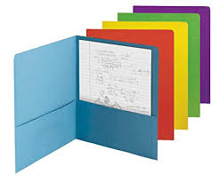
ALL EXAMINATIONS
Media Studies
Your books, revision folders and knowledge Organisers are your primary revision materials. (Plus the revision guide, if you have one)
Read through and highlight information on each topic
Any tasks not filled in complete them for revision
Make notes on what you have read- bullet points, mind maps, images or even record your notes
Use post-it notes to highlight the areas you are unsure of and need
to revisit
As you read your notes write a list of any questions you have about
a topic then ASK ME for the answers

Slide 4

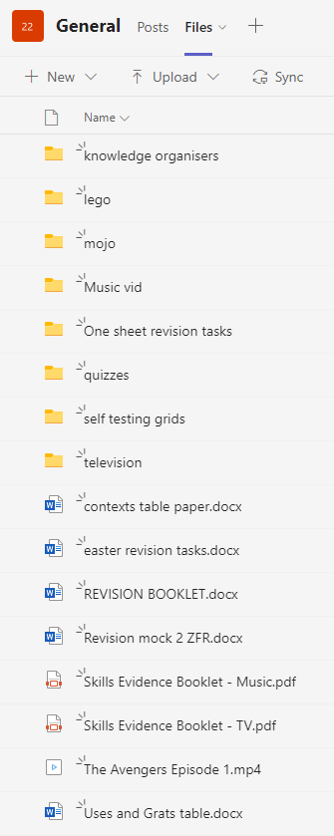
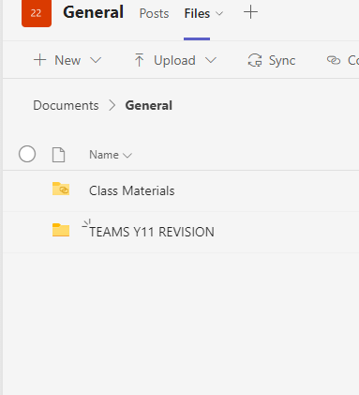
ALL EXAMINATIONS
Media Studies
Access the REVISION FOLDER ON TEAMS
WATCH CUFFS/AVENGERS AGAIN

Slide 5


ALL EXAMINATIONS
Media Studies
Make some flash cards.
These will only be good for small pieces of
information that you need to know or definitions:
Regulatory bodies- TV/Ofcom etc
Lego movie information- use of intertextuality/television ad
MOJO magazine- Owner/Bauer Media
You should go through each topic and think about small pieces of information that would work with the flashcard strategy.
Use the TERMINOLOGY Look-cover-write-check-sheet
THIS CAN NOT BE YOU ONLY FORM OF REVISION!

Slide 6
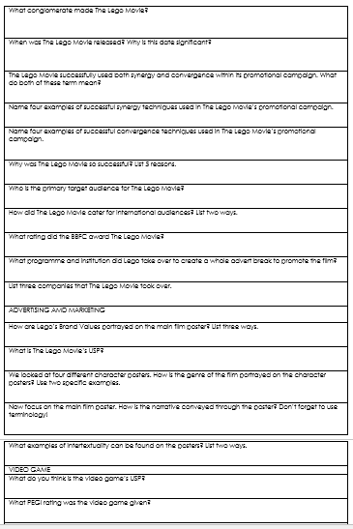

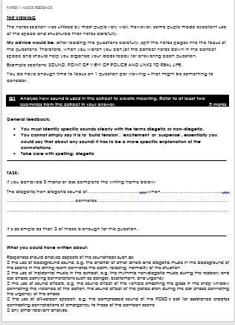
ALL EXAMINATIONS
Media Studies
REVISION quizzes for LEGO MOVIE and CUFFS/AVENGERS
Versions are saved on system for you to print and have a go!
ONE SHEET REVISION - FOR EACH TOPIC
Go back to mock examinations and therapy booklets -read through
model responses. Redraft any answers where you think you have struggled

Slide 7
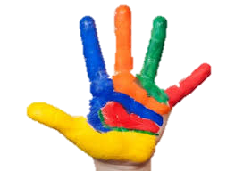
ALL EXAMINATIONS
Media Studies
CUFFS
Influence of social and cultural context
feminism
masculinity
multiculturalism
sexulaity
police
Industry info: scheduling, channel, PSB etc
Representation women
men
ethnicity
stereotypes etc
Audience
Revision of media language terminology
Application of uses and gratifications theory
Self testing tasks
Use 2 colours complete a self testing activity. In one colour list all the things you can remember about a topic.
When you have written EVERYTHING you can remember then you should use books, revision guides and knowledge organisers to fill in the gaps in another colour.

Slide 8

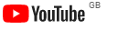
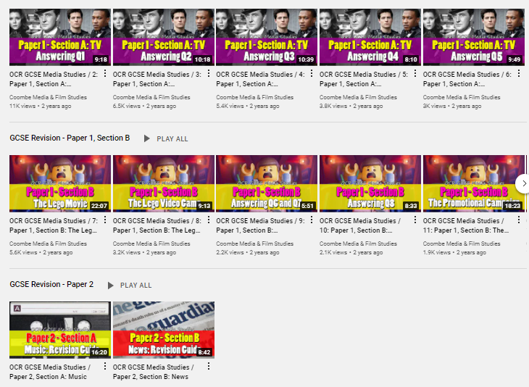
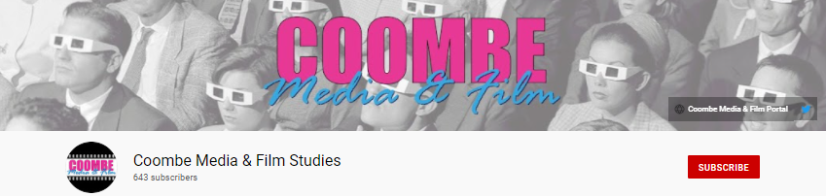
ALL EXAMINATIONS
Media Studies
https://www.youtube.com/channel/UCWfbvc0fwWLpTZk8PdF30Kg
Watch the revision videos for each section on COOMBE MEDIA PAGE ON YOUTUBE

Slide 9

ALL EXAMINATIONS
Media Studies
Exam practice
You do need to write example responses to questions.
We know you MIGHT be asked a question on 1960’s Observer papers- so write a practice response and hand it in to be marked
‘How do 1960’s newspapers reflect different social/political/historical contexts? Use references to set texts in your answer
10 marks
You know you MIGHT be asked a question on the influence of CONTEXT of CUFFS OR AVENGERS so write a practice response and hand it in to be marked
‘How do television programmes reflect different contexts? Use Cuffs in your answer
10 marks

Slide 10
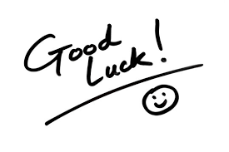
2023
ALL EXAMINATIONS
Media Studies
WALT: identify different ways to revise topics

