Slide 1

Wellington School
GCSE Maths Revision
2024
Mr. A Hodson
Head of Maths

Slide 2
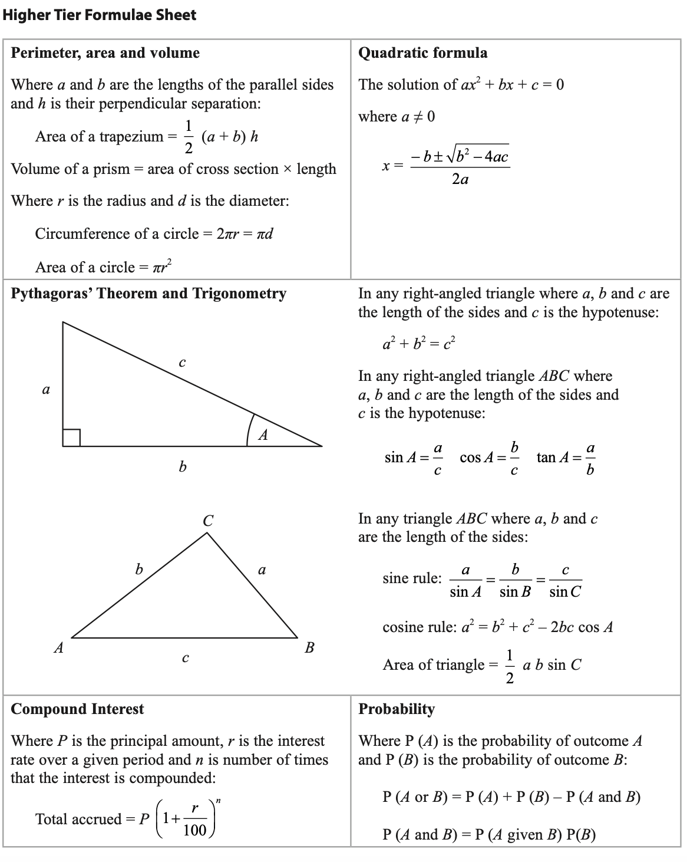
Exam Board – Edexcel (Pearson)
Higher Tier (Grades 3 - 9)
Foundation Tier (Grades 1 - 5)
Paper 1 – Non-Calculator
80 marks
90 mins
Thursday 16th May (Morning)
Paper 2 – Calculator
80 marks
90 mins
Monday 3rd June (Morning)
Paper 3 – Calculator
80 marks
90 mins
Monday 10th June (Morning)
Formula Sheet:
EXAM
INFORMATION
Wellington School
GCSE Maths Revision
2024

Slide 3


Pen
Pencil
Ruler
Geometry Equipment (compasses and protractor)
Scientific calculator
  Casio FX83-GT range
REQUIRED
EQUIPMENT
Wellington School
GCSE Maths Revision
2024

Slide 4
PRACTICE, PRACTICE AND MORE PRACTICE…
  Topic Specific Revision
  Exam Practice
Edexcel
Complete online using Onmaths or
papers available with mark schemes and video walkthroughs on Maths Genie
Do a practice paper
Identify weaknesses
Work on the weakness
Practice exam questions on the weaknesses
Use the Sparx revision checklist or create your own from weaknesses.
HOW TO
REVISE MATHS
Exam questions by topic on MathsGenie and MathedUp
Revision guide, Sparxmaths, Corbett Maths
Wellington School
GCSE Maths Revision
2024

Slide 5
Little and often…start revising Maths early focusing on small sections of your weaknesses
Use your question level analysis from the last mock to ensure you know what you should be looking at to improve
Past Papers, Past papers, Past papers!!!
Complete your paper/questions in timed conditions, a minute for one mark is a rough and easy guide to use.
Come to revision sessions held in the department on Thursday after school
Ensure you have your calculator and you know how to use it.
Make sure before the test you prepare your bag the night before, get a good amount of sleep and have had breakfast.
Top Tips
for Revision
Wellington School
GCSE Maths Revision
2024

Slide 6
Edexcel (Past Papers and Mark Schemes)
Onmaths (Online Exam Papers)
  onmaths.com
Examq (Online exam questions from past papers)
  Examq.co.uk
Sparxmaths (online videos and questions)
  Sparxmaths.com
Maths Genie (Exam Style Questions on Every Topic)
  mathsgenie.co.uk
Mathed Up (Exam Style Questions on Every Topic)
  mathedup.co.uk
Corbett Maths (Practice Questions by Topic)
  corbettmaths.com
USEFUL
WEBSITES
Wellington School
GCSE Maths Revision
2024

