Slide 1
GCSE Preparation Evening Preparing for the History GCSE Examinations Mr Gerschler Head of History and Politics
Paper 1: Understanding the modern world Exam Date 15th May 2024
What's assessed? America, 1840–1895: Expansion and consolidation Conflict and tension, 1918–1939
How it's assessed? • Written exam: 2 Hours • 84 marks (including four marks for spelling, punctuation and grammar) • 50% of GCSE
Questions • Section A – six compulsory questions (40 marks) • Section B – four compulsory questions (40 marks) • Plus four marks for spelling, punctuation and grammar
Paper 2: Shaping the nation Exam Date 4th June 2024
What's assessed? Britain: Health and the people, c1000–the present day Norman England, c1066–c1100
How it's assessed? • Written exam: 2 Hours • 84 marks (including four marks for spelling, punctuation and grammar) • 50% of GCSE
Questions •Section A – four compulsory questions (40 marks) • Section B – four compulsory questions (40 marks) • Plus four marks for spelling, punctuation and grammar
+
Depth Study
Period Study
Thematic Study

Slide 2
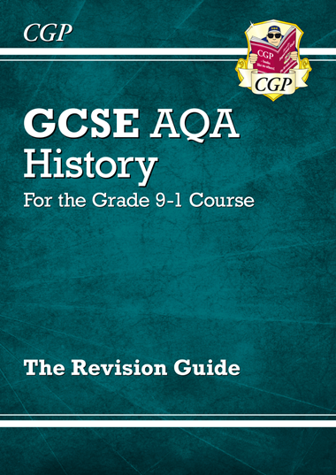
GCSE Preparation Evening Preparing for the History GCSE Examinations
Please check regularly that your son / daughter is revising.
Make sure revision happens at sensible times.
Purchase and encourage the use of the CGP revision guide.
Revision should begin with your son / daughter finding gaps in their knowledge and plugging those gaps by reviewing PLCs.
Then encourage your son / daughter to practise past paper questions (In timed exam conditions).
Encourage the use of GCSE Pod alongside the revision guides.
Attend Revision sessions.
Encourage your son / daughter to start revision early, sustain revision and stress the importance of challenging revision.
£3

