Slide 1


GCSE Design & Technology
Examination Advice & Revision Tips

Slide 2
EXAMINATION DATE
Tuesday 18th June 2024
What's assessed Core technical principles Specialist technical principles Designing and making principles
How it's assessed Written exam: 2 hours 100 marks 50% of GCSE
Questions Section A – Core technical principles (20 marks) A mixture of multiple choice and short answer questions assessing a breadth of technical knowledge and understanding. Section B – Specialist technical principles (30 marks) Several short answer questions (2–5 marks) and one extended response to assess a more in-depth knowledge of technical principles. Section C – Designing and making principles (50 marks) A mixture of short answer and extended response questions.

Slide 3

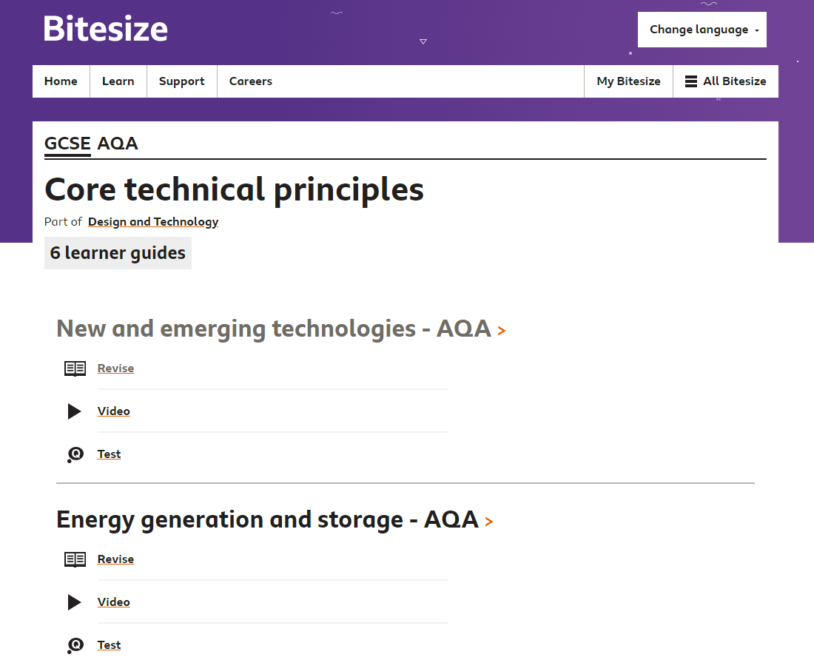
Section A – Core technical principles (20 marks)
A mixture of multiple choice and short answer questions assessing a breadth of technical knowledge and understanding.
To maximise marks in this section read the questions carefully highlight keywords and always use the process of elimination for the multiple choice questions.
Useful online revision resources
www.senecalearning.com an online revision platform where students can revise topics, complete tests and receive instant feedback.
GCSE Bitesize
www.bbc.com/bitesize/examspecs/zby2bdm revise a topic watch the video’s and complete the tests.

Slide 4
Section B – Specialist technical principles (30 marks)
This section assesses knowledge of their specialist area of study this is either Product Design or Textiles. It is important that questions are selected on the materials they have studied!
Several short answer questions (2–5 marks) with one extended response (8 marks) to assess a more in-depth knowledge of their understanding of the specialist area.
TIP: Reponses to short answer questions should NOT include vague words or responses it is important to justify answers e.g. this material is strong and durable because…
Useful online revision resources
www.youtube.com watching videos on specific manufacturing equipment, tools, techniques and processes to consolidate knowledge and understanding related to their specialist area of study (Product Design or Textiles).

Slide 5
Section C – Designing and making principles (50 marks)
A mixture of short answer and extended response questions (3 to 8 marks).
These questions focus on the investigation, mathematical data, the work of others, design strategies, communication of design ideas, prototype development, material management, specialist manufacturing & processing techniques.
TIPS: Knowledge of key words and terms are important in the section.
Planning extended answer questions is important as this will keep answer focussed and included relevant points.
Useful online revision resources
GCSEPod www.gcsepod.com watch or download the podcasts which will help identify key facts & images to reinforce learning.

Slide 6
GENERAL REVISION TIPS
Re-reading lesson notes to clarify knowledge & understanding of what has been taught in lessons. This must be done after each lesson to identify gaps in their knowledge. And anything they don’t understand, ask their subject teacher to revisit in lessons!
Glossary of key words and terms is vital, revise the meanings is also useful for Section B & C questions.
Revision guides, these are graphic knowledge organisers these have been created by subject teachers. Read through the topics highlight the key information.
RAG rating their knowledge of topics for each section of the exam – evaluating what they know and what areas they need to focus their revision!
Complete past papers, practise exam technique including timed conditions.

