Slide 1
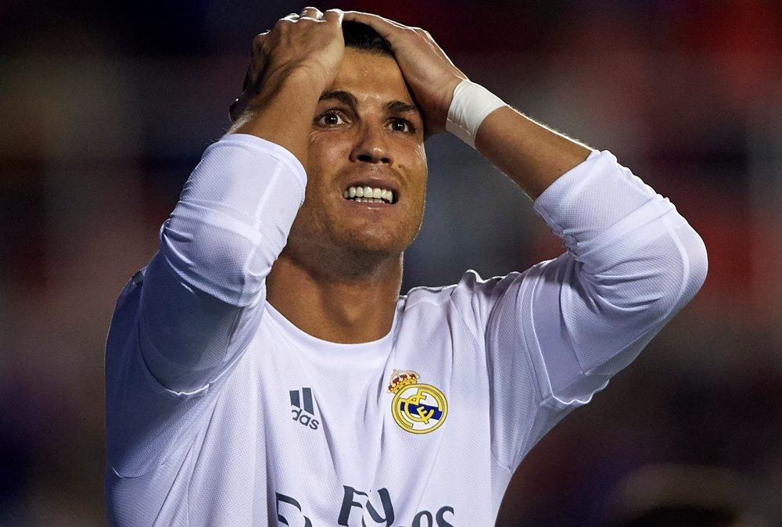
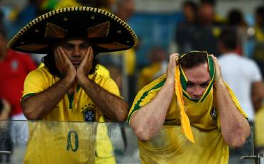
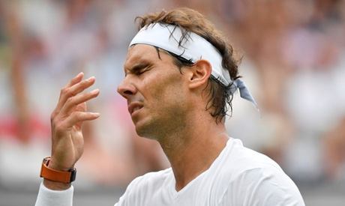
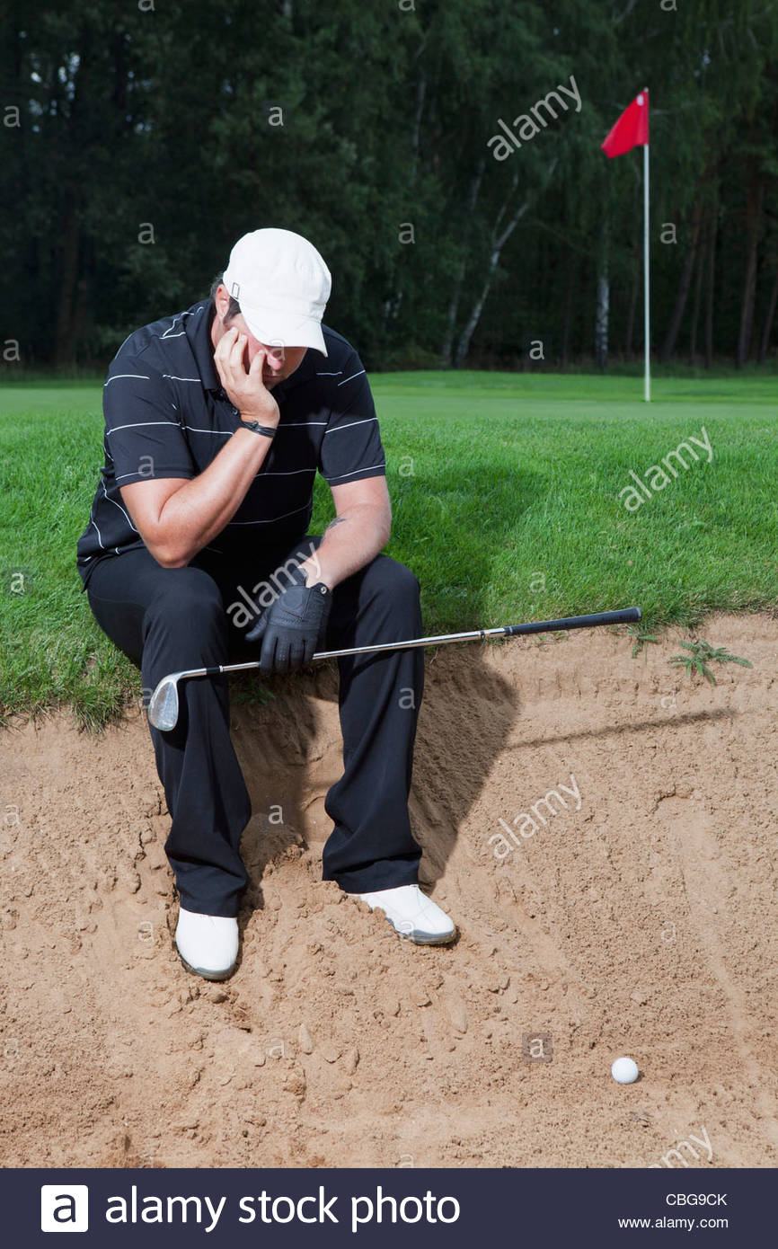


Slide 2

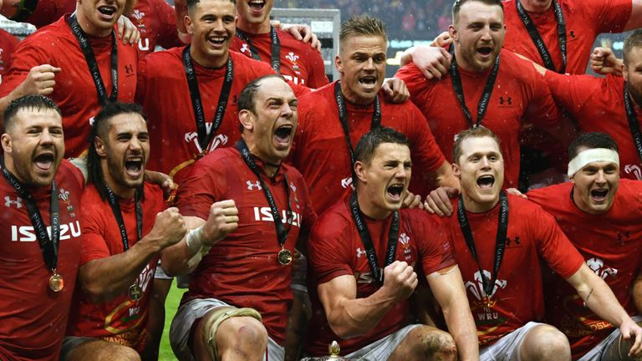
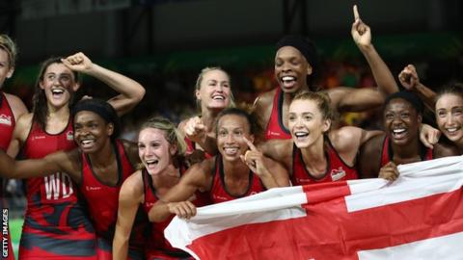
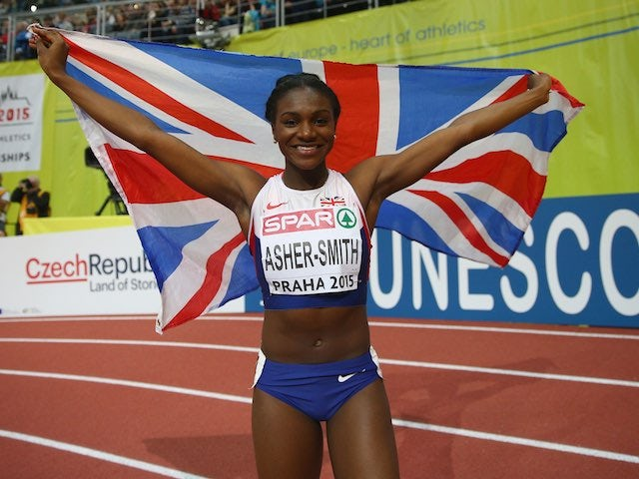

Slide 3
Why is our subject different?
40% of the GCSE PE course is coursework: 2 sports 1 written analysis – these marks have been finalised by PE staff! Our centre will be moderated on Friday 29th April to check staff have marked accurately.
60% of the course is examined by a final 2 hour written exam, 120 marks in total. Tuesday 24th May.
It is important for students to understand assessment objectives
‘style of question’
AO1 = identify AO2 = explain AO3= evaluate/analyse/discuss
2 years of course content needs a structured revision programme leading up to the exam. Please help us and check this is taking place.

Slide 4
60% minimum on the exam paper!!
This will mean a level 5.
Combine this with good coursework and you can look at 6 and above.
70% and above to hit the high 7-9 grades.
This is all achievable with hard work and a desire to succeed.

Slide 5
How else can you revise?
Attend your teacher’s extra lessons.
Use past exam papers and mark schemes
Make your own cue cards on key topic areas / quizlet
Post it notes – use for key terms and definitions
Create a revision file of printed out worksheets and revision notes.
Highlight key phrases in your old exercise books
Mindmap each topic area.
Revise with a partner – a friend who does the course

Slide 6
Useful resources
Eduqas online – topic checklist – course content – examiner review of questions. Past papers are available on request as well.
Exercise books – dig out your old exercise books to help with revision.
Question practice – your teacher will have past questions and mark schemes.
Exam technique booklet / PLC’s / Definitions – from class teacher
Dept revision guide – see class teacher

Slide 7
Useful websites
www.gcsebitesize - An excellent source of GCSE PE work
www.s-cool.co.uk/gcse/pe - More revision questions and answers
http://www.eduqas.uk - Our exam board - have a read over the specification to see what the examiners want to see for those higher grades – use question bank
*SENECA/QUIZLET

