Slide 1

How to prepare for Geography…
Do I know when the exams are in Geography? Do I know what is on each paper?
Do I know which topic is my weakest for each paper? What do I do about this?
  They should create revision summaries/work through the revision booklets to consolidate their knowledge. They must then practise exam questions for this topic and hand to their class teacher. These resources are available on Class Charts.
Do I know what support is available in school to help me prepare?
  There are revision sessions every week. Students are also completing exam questions which are set as homework. They are also showing evidence of revision in their purple exercise book.
Key dates
Pre- release booklet received on the 22nd March – tested in Section A, Paper 3
17th May: Paper 1, 1 hour 30min
  Hazards (tectonic, weather and climate change)
  The Living World (ecosystems, tropical rainforests and cold environments)
  Physical landscapes (coasts and rivers)
5th June: Paper 2, 1 hour 30min
  Urban Issues (Rio and Manchester)
  Economic World
  Resource Management (overview of all resources, then focus on water as a resource)
14th June: Paper 3, 1 hour 30min
  Pre-release booklet
  Fieldwork questions

Slide 2
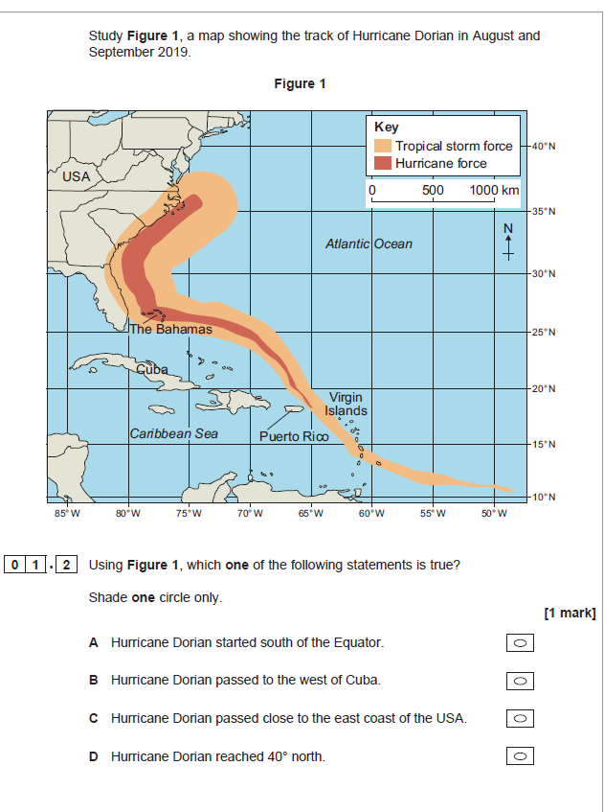
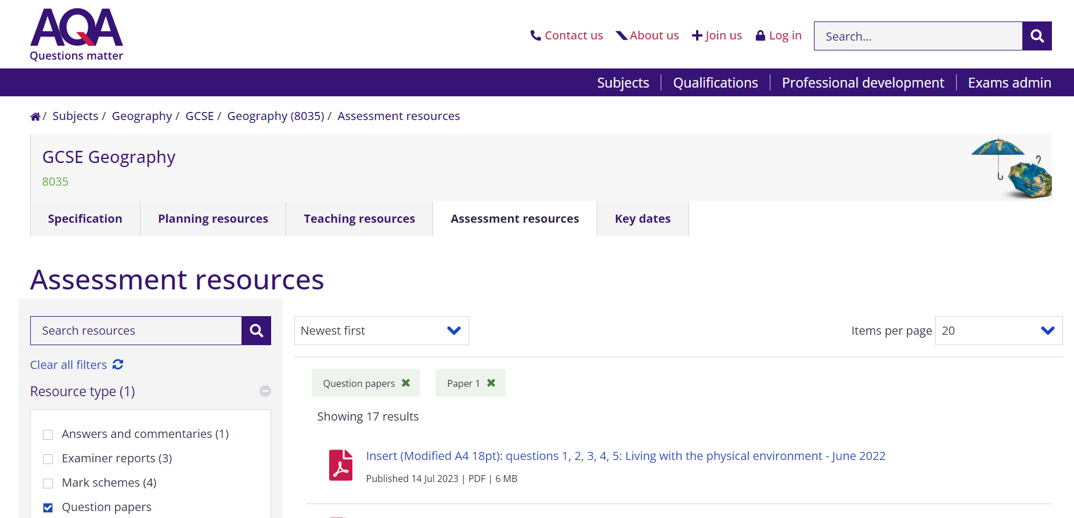

Slide 3
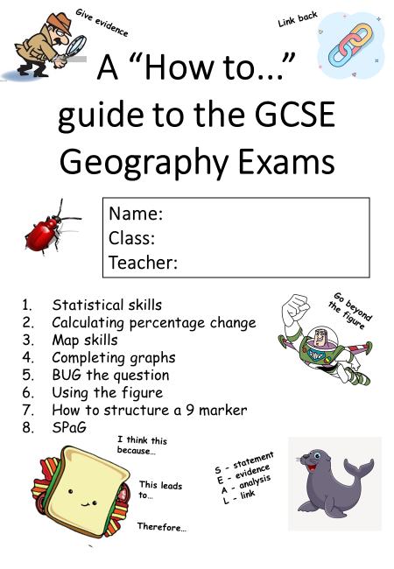
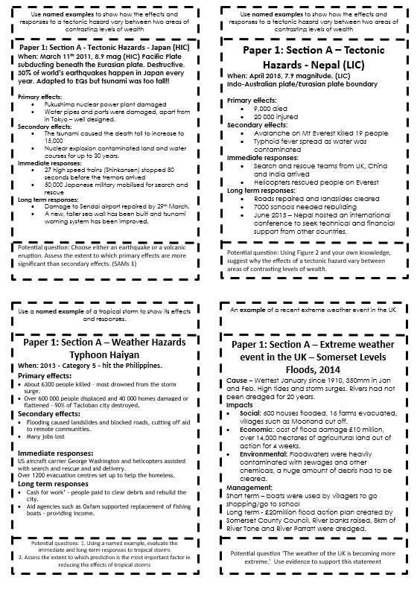
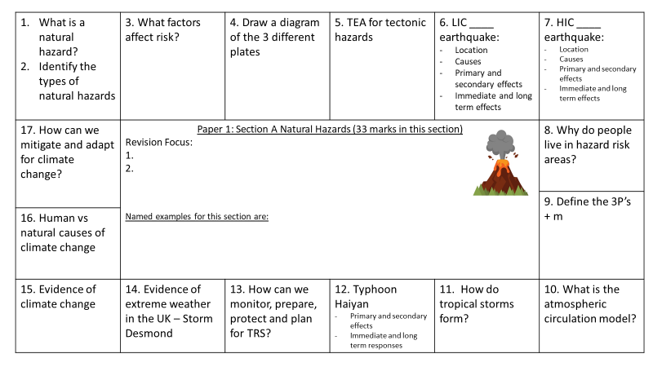
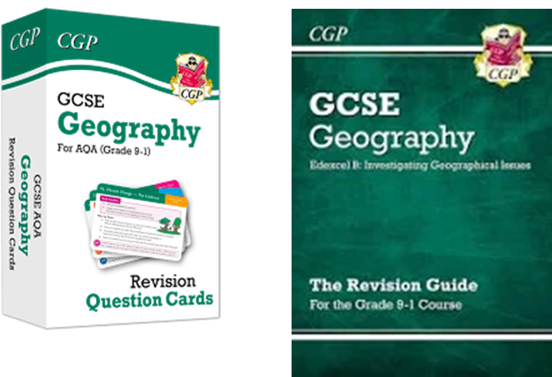
Case Study Cards
Revision Grids – Purple Ex. Books
Flash cards and revision guide

