Slide 1

GCSE Business

Slide 2
Assessment Reminder
Exam board: Edexcel
GCSE Business consists of two examinations that are completed at the end of Year 11
Both examinations are 1hr 45 minutes long and consist of a range of questions, including:
  Multiple choice
  Calculation
  Short answer & long answer (1 - 12 marks)
  Answers in sections B&C must be in the context of the case study provided
During each exam will also be provided with a separate case study booklet consisting of 2 separate case studies – section B and C
There is no controlled assessment for GCSE Business

Slide 3
Key Exam Information
Unit | Unit Content | Weighting | Exam Date
Theme 1: Investigating small business (Yr10 Content) | Enterprise and entrepreneurship Spotting a business opportunity Putting a business idea into practice Making the business effective Understanding external influences on business | 50% | GCSE Business Studies Paper 1: Investigating Small Business Tuesday 14th May PM
Theme 2: Building a business (Yr11 Content) | Growing the business Making marketing decisions Making operational decisions Making financial decisions Making human resource decisions | 50% | GCSE Business Studies Paper 2: Building a Business Wednesday 5th June PM

Slide 4
Revision Resources
Ensure you use the full range of revision resources that have been provided, including:
Class folders
Flash cards
Edexcel GCSE Business revision guide
Tutor 2U Edexcel GCSE Calculation practice booklet
Tutor2U Revision Blast videos
Exam technique cheat sheet, key terminology summary and key formula sheets
Tutor2U website
GCSE Pod website
Revision mind maps (A3) – Theme 1 and 2
Knowledge booklets – Theme 1 and 2
Past papers and mark schemes (On CC)
Exam technique presentations (On CC)

Slide 5
Exam Technique
Quick Recap

Slide 6
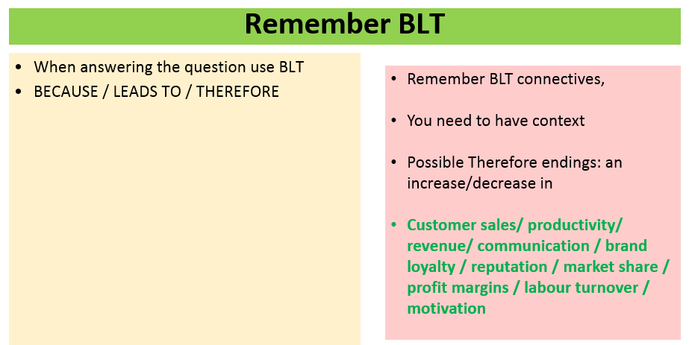
Using BLT to develop your arguments

Slide 7
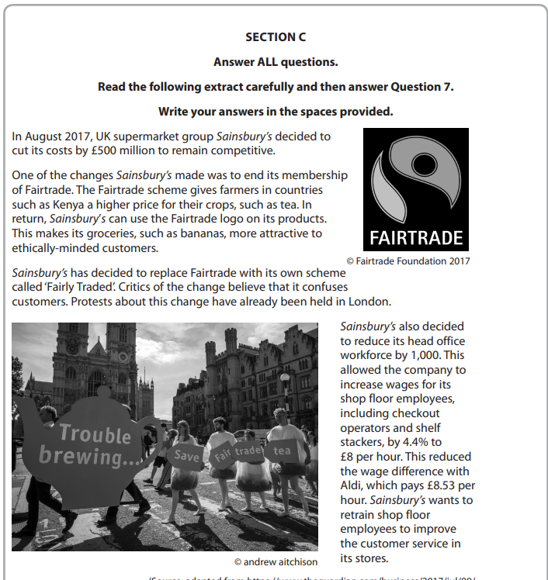

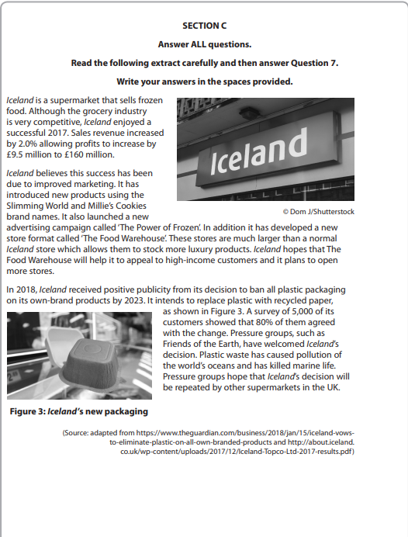
Section B&C – Remember the importance of context for ALL Q’s!

Slide 8
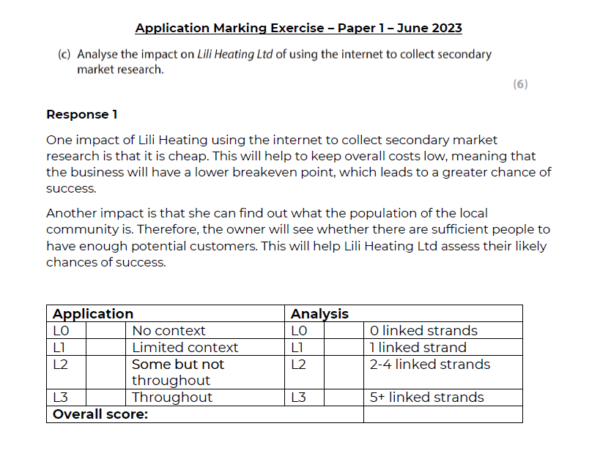
Answering 6 mark questions
3 marks for context (A02)
3 marks for analysis (A03a)

Slide 9
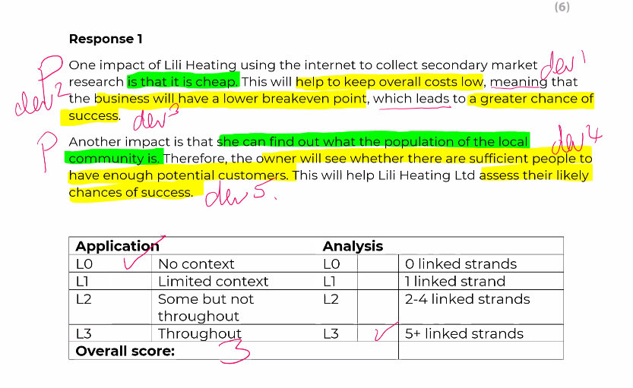
Response 1 – no context
3 marks for analysis
0 marks for context

Slide 10
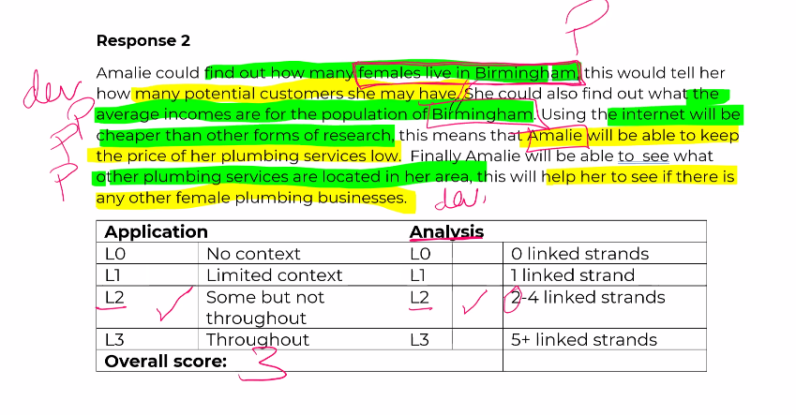
Response 2 - Not fully developed points
3 marks for context
2 marks for analysis

Slide 11
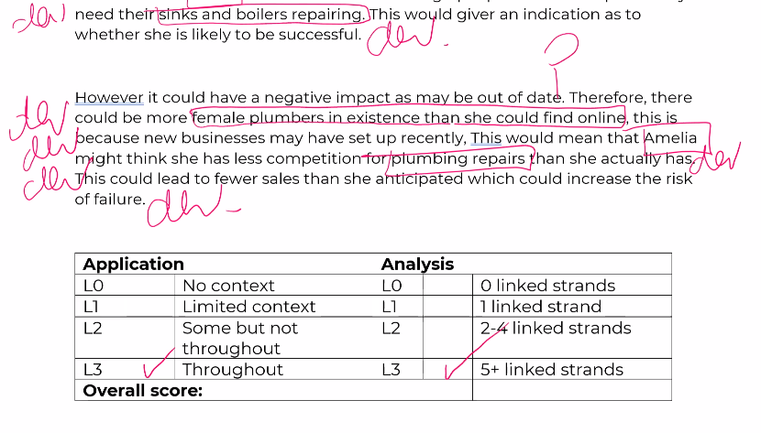
Excellent Response 3
3 marks for context
3 marks for analysis

Slide 12
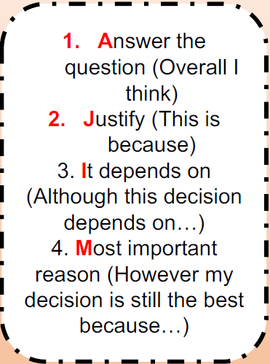
9 Marker structure
I suggest the BUSINESS NAME picks…
Paragraph 1
One advantage of the chosen option is… Because….This would lead to… Therefore…
Paragraph 2
One disadvantage of the chosen option is… Because….This would lead to… Therefore
Paragraph 3
AJIM Conclusion

Slide 13
12 Marker structure
Para 1 – It is, supports decision (1 advantage is enough)
Para 2 – It isn’t, against (1 disadvantage is enough)
Context
M – Market
What kind of market is the business in? Who are their competitors?
O – Objectives
What are their objectives? Increase revenue? Increase profit? Innovate? Improve product range?
P – Product
What products do they sell/services do they provide?
S – Situation
Does the business have any problems? Financial, suppliers, any current employee problems? Does this business have areas that it needs to improve?
Para 3 – AJIM Conclusion
Remember add NEW VALUE – DO NOT REPEAT YOURSELF!)…
LINK TO MOPS

