Slide 1
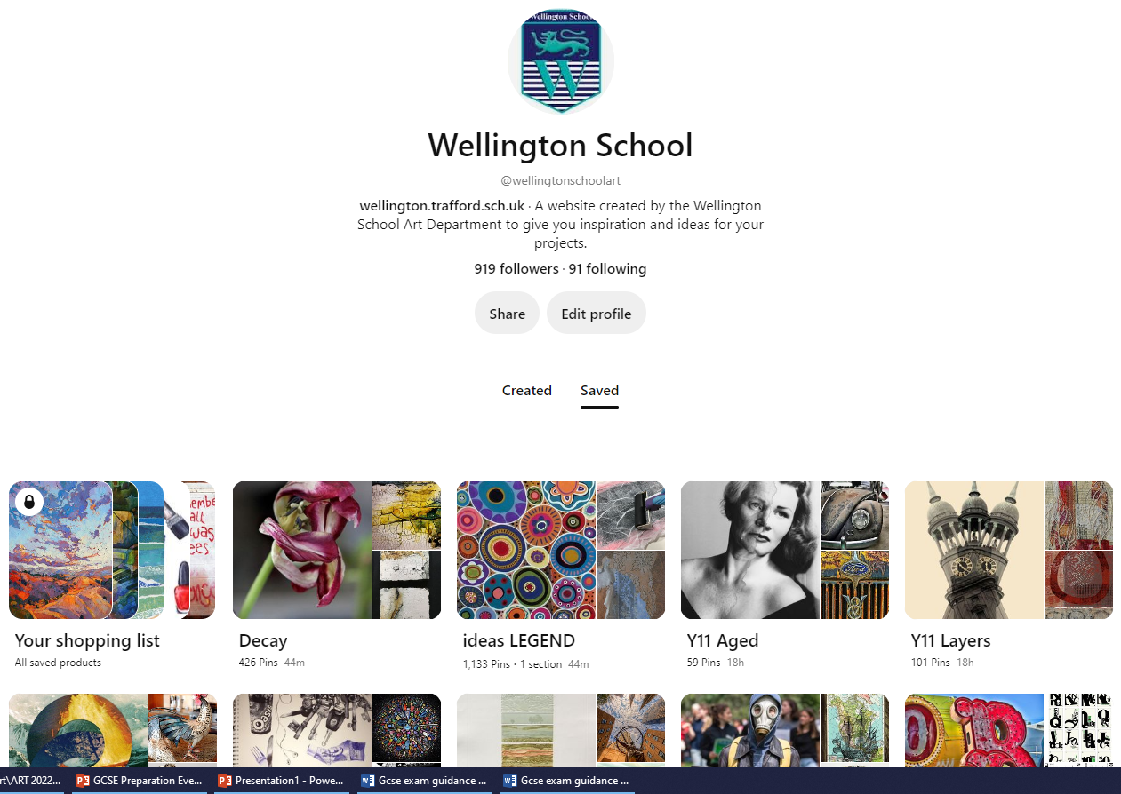
GCSE Art, Craft & Design
Exam dates Thursday 20th April 2023
Friday 21st April 2023
Exam paper released and issued
Students will have selected a question to respond to – we have created a series Pinterest (@wellingtonschoolart) boards to support their choices
Preparatory work will address the Assessment objectives
AO1: Develop ideas through investigations, demonstrating critical understanding of sources.
AO2: Refine work by exploring ideas, selecting and experimenting with appropriate media, materials, techniques and processes.
AO3: Record ideas, observations and insights relevant to intentions as work progresses.
AO4: Present a personal and meaningful response that realises intentions and demonstrates understanding of visual language.

Slide 2
We have advised students to work to their strengths in their question choice
Guidance and support is provided for the students to meet the outlined criteria and help manage their time
All directed tasks address the Assessment Objectives – as classwork, mock exam or homework
Time is available to complete work in the department at lunch or after school, students should check with staff for availability
There will be some Easter school sessions available
Please follow the guidance & use the support provided

Slide 3
Prior to the exam, the student will have completed their designs so they are going into the exam knowing what to do/create/make
There will be a planning sheet for use of time in the exam – 5 hours each day – students do get their break and lunchtime!
All preparatory work needs to be in school prior to starting the exam, it cannot be accepted after the exam has started
Students need to sign a coursework and exam declaration form, that will be issued by staff. It is exam regulations to do so and a grade cannot be awarded without this
Once the exam is complete, students will have 1-2 lessons to do organisation of folders/housekeeping and then class time will be used for revision for other subjects

