Slide 1
GCSE DRAMA REVISION TECHNIQUES

Slide 2

The Drama exam
The exam is worth 40% of the overall grade.
The exam is split in to 3 sections:
Section A = theatre terminology/job roles (4 marks)
Section B = study of Blood Brothers (344
Section C = Live Theatre review

Slide 3
Section A – What should I revise?
Job roles and responsibilities
Staging configurations
Drama and theatre terminology
Staging, set, lighting and sound terminology.
Where can I look at this?
https://www.bbc.co.uk/bitesize/guides/zhx3pg8/revision/1
https://files.schudio.com/durhamjohnston/files/documents/GCSE_DRAMA__Year_10_Task_3-Theatre_roles_and_terminology_task_sheets.pdf
https://www.bbc.co.uk/bitesize/guides/zjwp2sg/revision/1

Slide 4
Section B – How do I revise
The exam board will give you an extract from the play. This could come from any part of the play with any of the main character.
4 mark, 8 mark, 12 mark and 20 mark question.
44 marks for this section of the paper.
Revision tips: Re-read the play, look at the journey of each of the characters, pick out key scenes for each character, research social, historical and cultural background of the play.

Slide 5
Section B- 4 mark question
4 mark question – lighting, sound, costume, props and set.
Research into the social, historical and cultural areas of the 1970’s. What did they wear? What was popular? What did the rich wear? What did they wear for school?
Know your terminology – this can be revised from revision books/ BBC Bitesize.

Slide 6
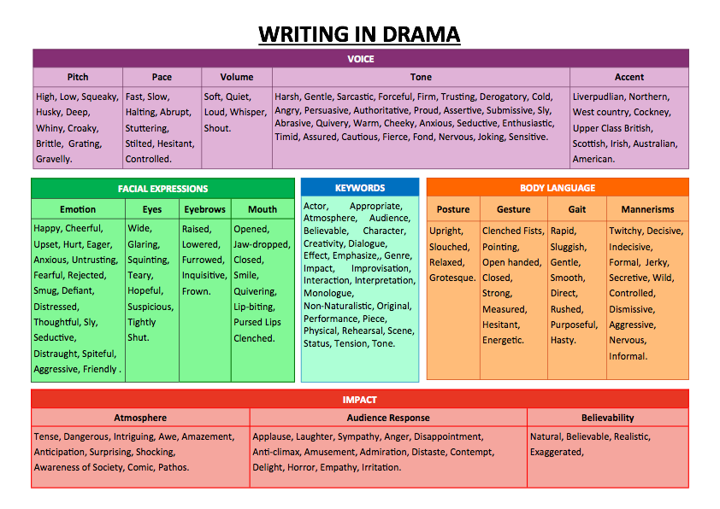

Slide 7
Section B – 8 Mark question
8 mark
Intro – context of the line in the extract
1st section of line, vocal, physical and impact of this on the audience.
2nd section of line, vocal, physical and impact of this on the audience.
3rd section of line, vocal, physical and impact of this on the audience.
You need to be able to use performance terminology through out.

Slide 8
Section B – 12 mark question
12 mark
Intro – what is the context of the shaded part of the extract? What is your character feeling? How does this link to the effect?
Staging of the two characters – Downstage, centre stage, upstage, set, props, proxemics and orientation – link to effect.
Pick a line, vocal and physical, impact, interaction and effect.
Pick a line, vocal and physical, impact, interaction and effect.
Pick a line, vocal and physical, impact, interaction and effect.

Slide 9
Section B – 20 Mark question
20 mark
Introduction – everything you know about the character in the play
Pick a line, vocal and physical, impact – link to context outside the extract
Pick a line, vocal and physical, impact – link to context outside the extract
Compare or contract to another section of the play – pick a line, vocal and physical and impact
Pick a line, vocal and physical, impact – link to context outside the extract
Pick a line, vocal and physical, impact – link to context outside the extract
Compare or contract to another section of the play – pick a line, vocal and physical and impact

Slide 10
Section C – Live theatre review
For this section you will be reviewing a live theatre performance you have watched. You can adapt the original essay to the question.
Intro – What are you reviewing? Name, actors, genre and style. Why is this actor relevant to the question?
Then you go on to your review – you must use the wording of the question in your following paragraphs. I would aim for 4 paragraphs about the review. Use your quotes table to help you – see next slide.

Slide 11
MOMENT | VOCAL PERFORMANCE | PHYSICAL PERFORMANCE | SHOWS | IMPACT
Walks from oven to table carrying radio | - | Stumbling gait, short, fast steps, confused facial expression – frowning, downturned mouth, holding radio to her ear. | Portrays older character, frail, hard of hearing, not understanding what’s going on in the world. | Positive response from audience – protective of her.
Radio gets turned off. ‘Ey I was listening to that.’ | 2 second pause after radio has been switched off then a loud volume, Geordie accent, annoyed tone, low pitch, gravelly voice emphasising ‘Ey’ | Big wafting gesture towards Jackie then sitting down with her ear next to the radio, eyes down, focus on the floor, concentrated facial expression – furrowed brow, lips pressed together in a straight line. | Slow reactions so not sharp mentally, strong personality, knows what she wants, not afraid to speak out. | Sympathy – she doesn’t get treated well by Jackie.
‘What do you know about political aggravation?’ | Mimicking Tony, lower pitch, same phrasing he had but emphasising ‘you’. | Rolling her eyes. | Disagrees with the strike, confrontational, not sharp mentally – gets the last word wrong – ‘aggravation’ instead of ‘agitation’. | Comedy – funny to see the Gran mocking the grandson
‘You’re wearing a bloody bikini!’ | Increased volume, fast pace, accusing tone. | Looking him up and down, smirking facial expression, pointing at Jackie’s apron | Disagrees with how they behave. Shows eccentric and cheeky personality. | Comedy – funny to see her mocking her son – miner wearing a bikini apron.
‘Where’s my pasty?’ | Lower volume, slow pace, whiny tone, pausing after each word emphasising ‘pasty’ | Stood with a slumped posture, shoulders rounded, head down, looking around for the pasty, pained facial expression, pouting lips, low eyebrows, half closed eyes. | She hoards food and is forgetful due to her dementia which upsets her. | Sympathy – we don’t like to see her upset as have a positive relationship with her.
Watching Big Davey make and eat his bacon sandwich | - | Disgusted facial expression, focus flicking between him and the sandwich, snatches ketchup and quickly hides it before flashing him an innocent smile – eyes wide, head tilted to one side. | She disapproves of him eating the burned bacon and still has her wits about her to trick him. | Comedy – exaggerated reactions and perfect comic timing.
Billy enters - ‘Hello son.’ | Cheery, kind tone, draws out ‘Hello’ | Smiling facial expression, keeps her focus on him as he moves around the kitchen, posture gets more upright, shoulders and head lift. | Shows that she loves Billy and has a stronger connection with him than the others. | Positive – we are pleased she has a good relationship with Billy.
‘Oh thank the Lord, I thought they’d eaten it’ | Loud volume, excited tone, fast pace, emphasis on ‘Thank’ and ‘Lord’, slower pace for second part of line. | Hold pasty up at head height, ecstatic facial expression – eyes wide, beaming smile, focus on the pasty, posture totally upright, broad shoulders, head high. | Shows how simple things make her happy, reminds us of her larger than life personality. | Feel happy for her as we are on her side

