Slide 1


Options
2025
To foster an inclusive community built on our shared values, where individuals thrive, find purpose, and make a positive impact on the world. Through education, we equip young people with the knowledge, skills, and mindset to effect meaningful change

Slide 2
Which subjects are mandatory?
GCSE
English Language
English Literature
Mathematics
Combined Science (2 GCSE’s)
Religious Education (Short Course GCSE)
Non examined subjects
Physical Education
Curriculum for Life (PSHE)

Slide 3
Options
4 options, 1 ‘Ebacc’ Option and 3 ‘Open’ Options
Ebacc Options:
1. History
2. Geography
3. MFL (French or Spanish)
Can select two or all three through the Open Options.

Slide 4
Open Option Subjects
Art, Craft and Design German
Business History
Computer Science Information Technology* Creative Media Production* Media Studies
D & T: Food and Nutrition Music
D & T: Engineering* PE (GCSE)
D & T: Product Design Performing Arts*
D & T: Product Design (Textiles) Psychology
Drama RE (Full Course GCSE)
Enterprise and Marketing* Sociology
Further Maths and Statistics Sports Studies*
Geography Three Sciences
*VOCATIONAL AND TECHNICAL AWARDS

Slide 5
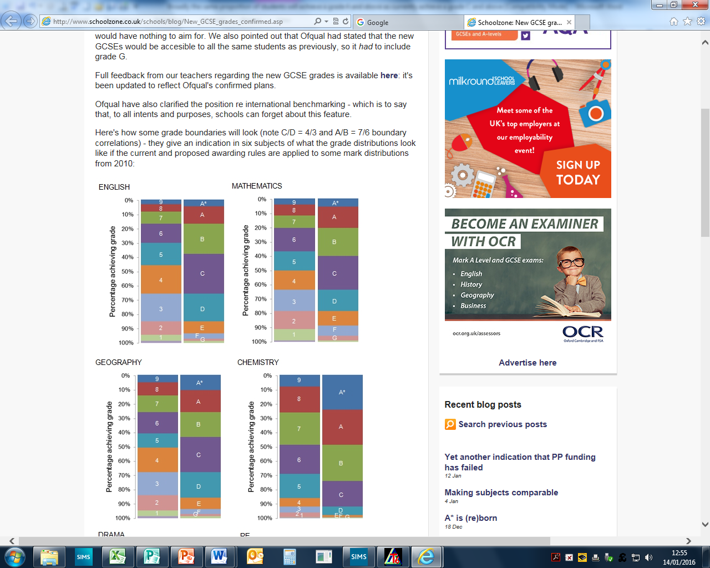
New GCSE Grades

Slide 6
GCSE Exams
2016
*English Lang. – 2 ¾
English Lit. – 2 ¼
*Maths – 3 ½
Combined Science – 6
French – 1 ½
*RE – 1 ½
DT – 2
History – 3 ½
Drama – 0
Total – 23 hours (17 exams)
2019 and beyond
*English Lang. – 3 ½
*English Lit. – 4
*Maths – 4 ½
*Combined Science – 7 ½
*French – 3
*RE – 1 ¾
DT – 2
*History – 3 ½
Drama – 1 ½
Total – 31 ¼ hours (21 exams)

Slide 7
Vocational and Technical Awards
Creative Media Production
D & T: Engineering
Enterprise and Marketing
Information Technology
Performing Arts
Sports Studies

Slide 8
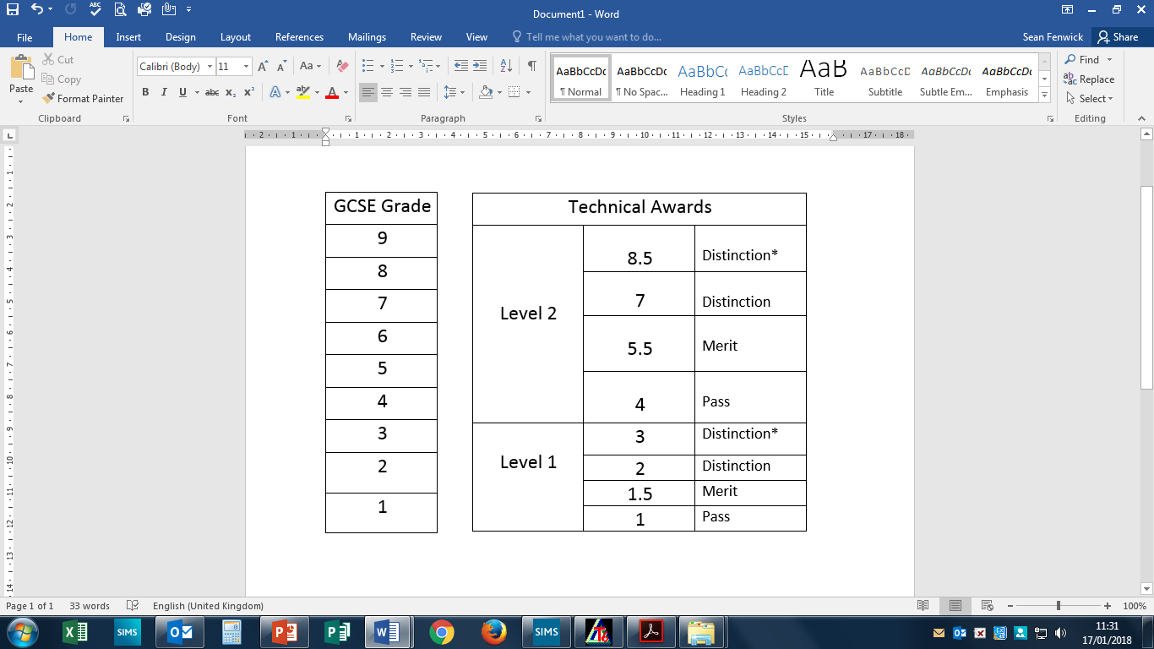
Vocational and Technical Awards

Slide 9
Broad and Balanced
One ‘D & T’ subject
Creative Media Production or Media Studies
Drama or Performing Arts
Physical Education or Sports Studies

Slide 10
Sport/PE and Drama/Performing Arts
On the option form it will have ‘Sport’ and ‘Performing’ as an option
The PE and Drama staff will pick the pathway which best suits the student
Sports Studies VTQ or GCSE PE
Performing Arts VTQ or Drama GCSE

Slide 11
Example 1
English Language GCSE
English Literature GCSE
Maths GCSE
Physical Education
Curriculum for Life (PSHE)
Combined Science 2 GCSEs
Religious Education (short course) GCSE
French GCSE
German GCSE
Psychology GCSE
Geography GCSE

Slide 12
Example 2
English Language GCSE
English Literature GCSE
Maths GCSE
Physical Education
Curriculum for Life (PSHE)
Religious Education (short course) GCSE
History GCSE
Biology GCSE
Chemistry GCSE Three Sciences Option (replaces Combined Science)
Physics GCSE
Art and Design GCSE
D & T: Engineering Vocational and Technical Award
Notes:
Education Act – core curriculum to raise standards to those of other countries /equivalences going / GCSE = gold standard
Sig + without equivalences
Wolf – music to our ears and confirmed white paper

Slide 13
Example 3
English Language GCSE
English Literature GCSE
Maths GCSE
Physical Education
Curriculum for Life (PSHE)
Combined Science 2 GCSEs
Geography GCSE
RE Full Course GCSE (replaces RE Short Course)
Creative Media Vocational and Technical Award
Sports Studies Vocational and Technical Award
Notes:
Education Act – core curriculum to raise standards to those of other countries /equivalences going / GCSE = gold standard
Sig + without equivalences
Wolf – music to our ears and confirmed white paper

Slide 14
Key Dates
7th January
Assembly to explain the Options Process to students
13th January – Options Evening
Evening for Parents to find out about the Options Process and speak to subject staff
27th January – Taster lessons
Students won’t follow their normal timetable for lessons 1 to 4. Instead they will select 4 subjects from the list of options subjects to have a taster lesson in.
Thursday 30th January – Parents Evening
An opportunity to hear about your son’s/daughter’s progress in the various subjects they take. Students will also attend
1st February
Options Form will go live
14th February
Deadline for the completion of the Options Form.
March onwards
You will be contacted if there is a problem with the choices.
May
If you have not been contacted at this point about a problem with the choices then you can assume you have got your preferred choices.

Slide 15
Contact Details
If your question is a general one about the options process then contact Mr Fenwick (Deputy Head teacher).
If the question is about a specific subject then contact the Head of Department.
Contact Details:
0161 928 4157
admin@wellington.trafford.sch.uk

