Slide 1
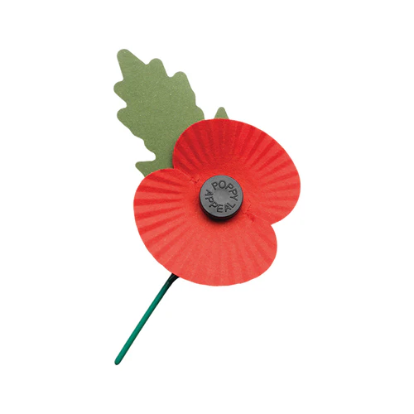
The Royal British Legion Appeal 2024
Poppies will be on sale in classrooms 42, 43, 44, 45 and 46 along the History corridor.
They will also be on sale in the LRC.
6th Form students will come around to visit your tutor rooms in morning registration.
There is no limit to how much you donate, however it is recommended that you donate £2.
Please, show your respect and appreciation for those who have sacrificed so much for our freedom.
Wear a poppy.

Slide 2
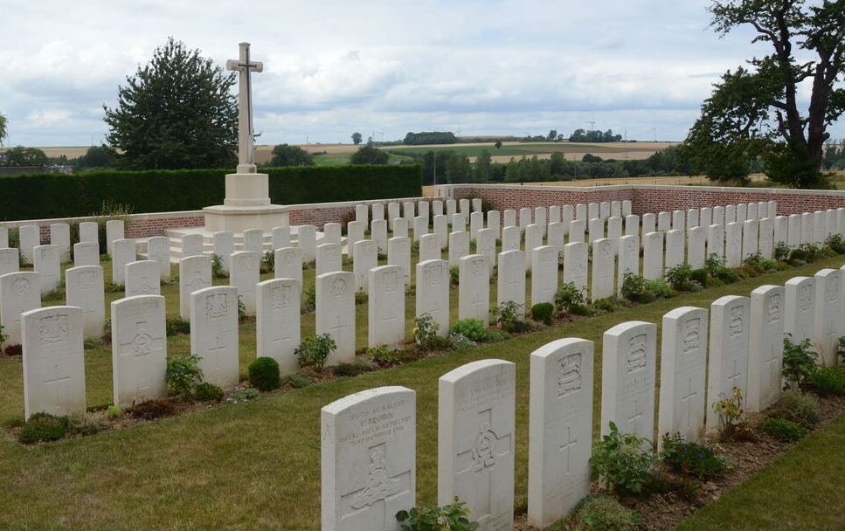
My poppy is for…
The ordinary people that sacrificed their lives. I wear a poppy to remember all the soldiers that volunteered to fight, especially those that signed up to fight in the First and Second World Wars. I think of the men that were teachers, footballers, factory workers…not soldiers. I like to remember that these individuals never planned to be soldiers, that they volunteered to help protect our country and to defend the rights and freedoms that we enjoy today. I like to remember my great-great Uncle William Greenough when I wear a poppy. William fought and died in the First World War, after signing up to serve in the Manchester Regiment when war broke out. Like many millions of others involved, he was just a ordinary man before 1914.
Mr Gerschler

Slide 3
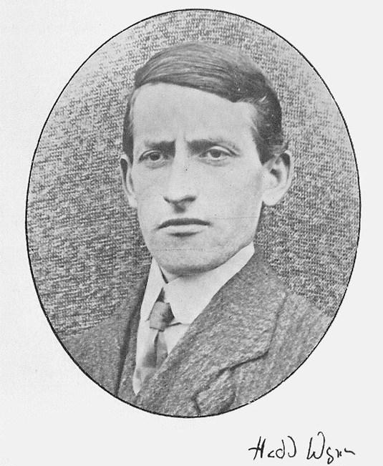
My poppy is for…
The people who are willing to give up so much of their lives to keep us safe in different ways, like Hedd Wyn. In July 1917, Welsh poet Hedd Wyn posted a poem titled Yr Arwr (The Hero) back to Wales from a village in France. He was on his way to fight in the trenches. His poem was his entry to the Eisteddfod, the annual festival of Welsh culture and language. When the Eisteddfod was held in Birkenhead that September, it was announced that a poet writing under the pseudonym Fleur di Lis was the winner. Trumpets sounded in anticipation of the poet identifying themselves. Nobody came forward. An official then announced to the crowd that the winner was in fact Hedd Wyn and that he had been killed in action weeks earlier.
Mrs Moorhouse

Slide 4
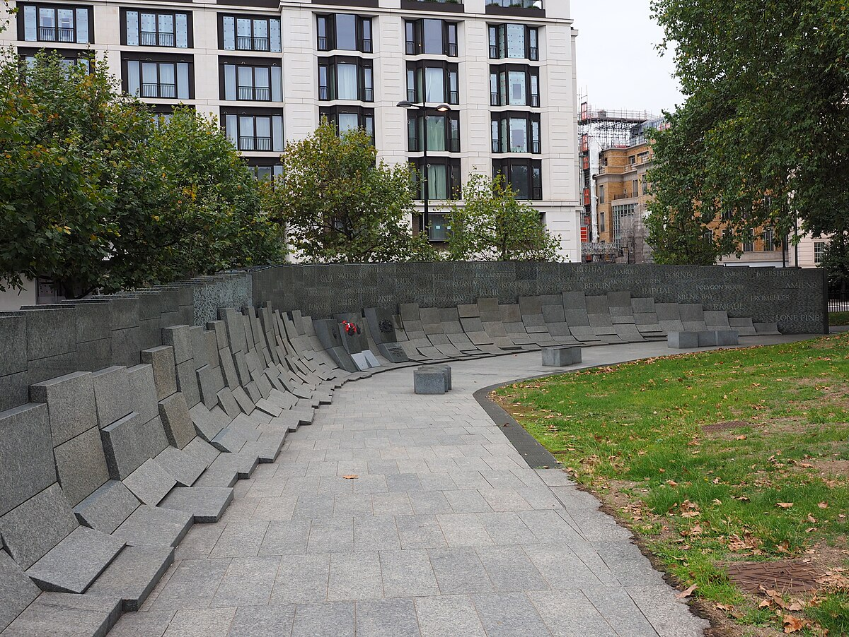
My poppy is for…
The soldiers who travelled so far to fight and die on the other side of the world. Poppies are also worn in Australia to commemorate the ANZAC. I think it's important to keep the horrors and grief of war alive in our minds so the international community can continue to do what we can to avoid another one.
Miss Hollis

Slide 5
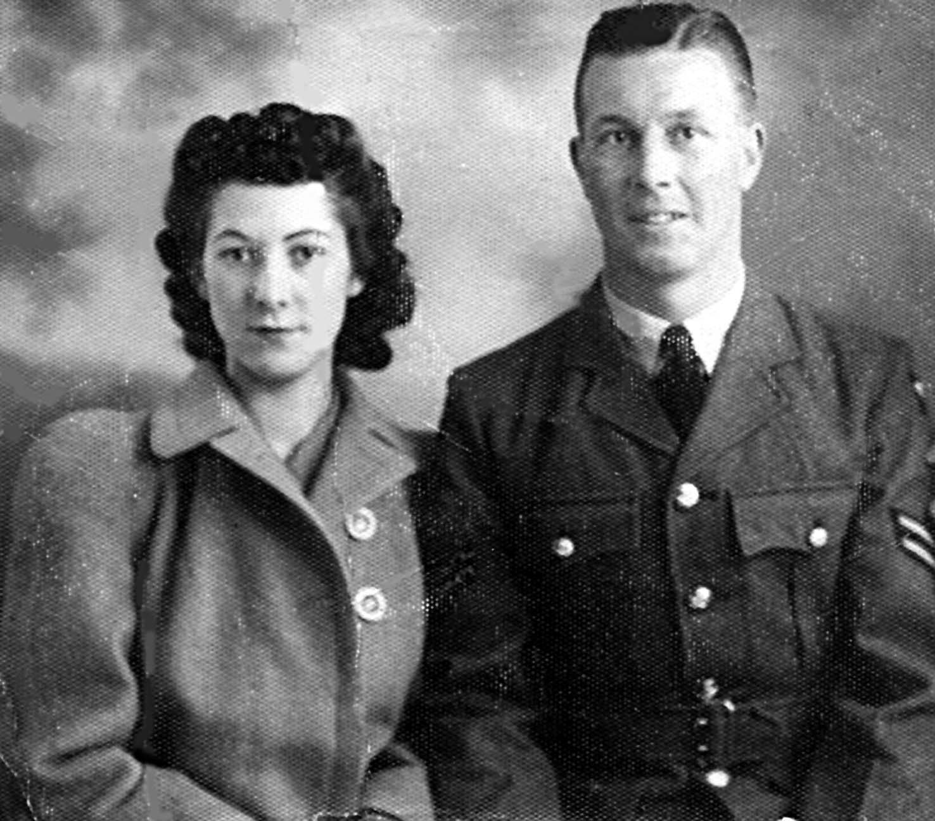
My poppy is for…
The honour and duty my great-grandfather demonstrated in WW1, which he fortunately survived. Likewise, my grand-father built Lancasters and Hurricanes during WW2: even though he wanted to be a pilot, he was blind in one eye so became an engineer instead! He also worked at the Woolwich Arsenal (where the Arsenal football team began!) and was seconded to many places around the world. The stories of the WW1 poets such as Wilfred Owen and Siegfreid Sassoon also fascinate me too and I pay tribute to those great writers by teaching their words.
Miss Hitchens

Slide 6
My poppy is for…
All the brave people that risked their lives during the wars, particularly my grandad. He was in the RAF in WW2 and survived the war, becoming part of the 'goldfish club', a worldwide association of people that escaped an aircraft into the water. He escaped the aircraft he was flying after being hit and parachuted into the water. When I was a little girl he used to let me wear his goldfish badge and parachute, and tell me stories about that time and the unimaginable difficulties faced by everyone. I’ll never forget…
Miss Tyrer

Slide 7
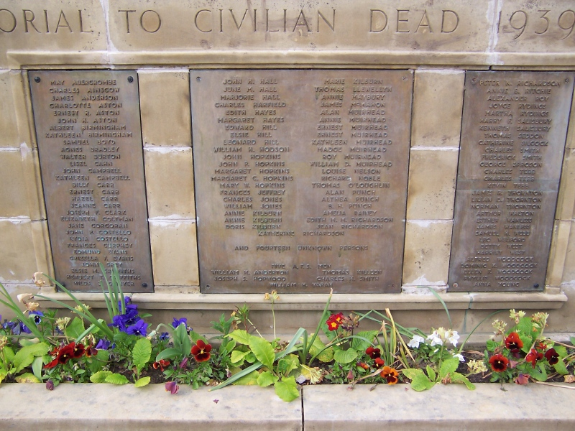
My poppy is for…
All victims of conflict. I wear a poppy each year to commemorate, mourn and pay respect to the 'victims' of all conflict, over time and today; not merely the soldiers on all sides but the innocent civilians tragically lost in events beyond their control. The poppy is also a reminder of mistakes humankind as made historically, ones we should endeavour not to repeat.
Mr Beeley

Slide 8
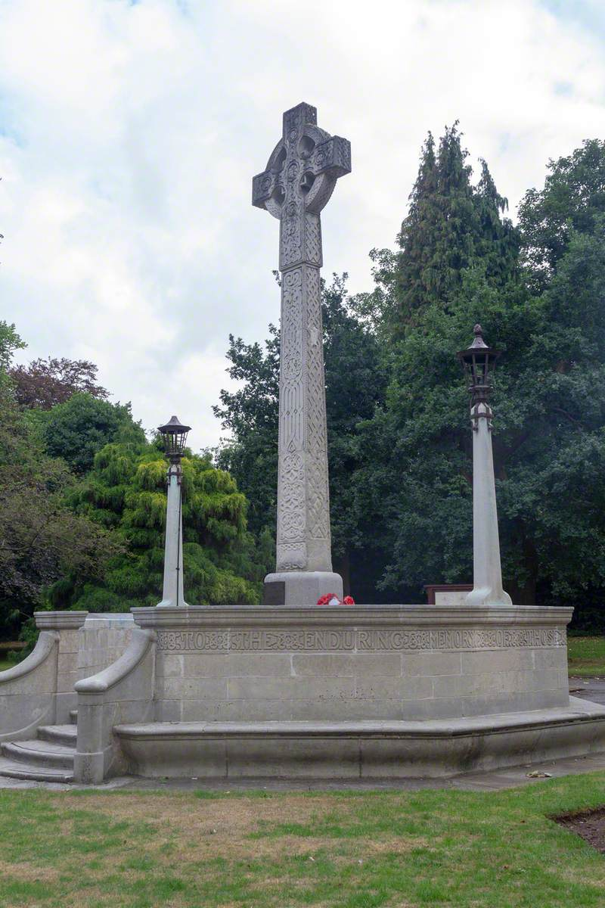
My poppy is for…
The sacrifice men and women have made in conflict over the years to protect our freedom of speech and our political freedom. I also recognise the service of those people who don’t want to engage directly in conflict but who support in humanitarian roles in warzones (such as doctors, nurses, ambulance-drivers and rescue teams). So many who served in the First and Second World War did so to fight for justice and freedom from tyrannical regimes. We should acknowledge that our rights today – including freedom to vote, freedom to express our views, education for all regardless of class or gender and freedom to worship - are a direct result of those battles fought decades ago.
Mrs Shields

Slide 9
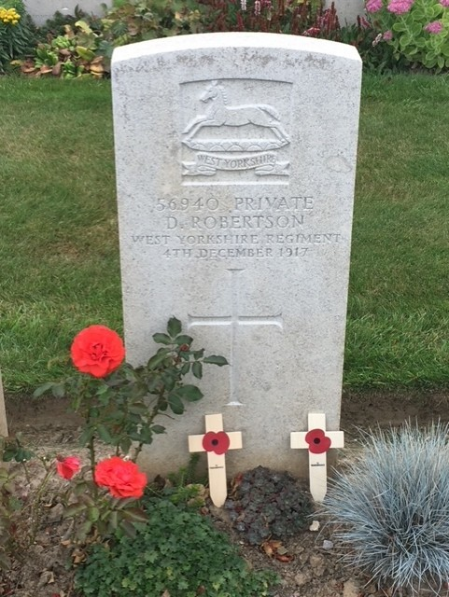
My poppy is for…
My great grandfather David Robertson who died in WW1, on 4th December 1917. He is buried at Grevillers British Cemetery. He died while fighting for the Yorkshire regiment (despite being Scottish) and never saw his daughter (my gran) who was less than 1 year old when he died.
Dr Davidson

Slide 10
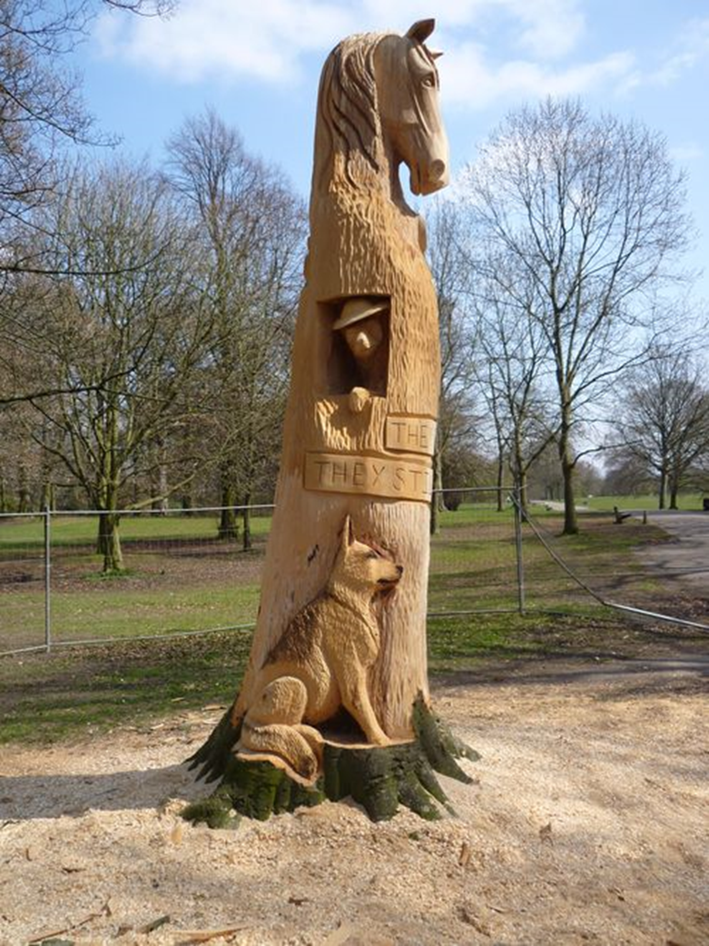
My poppy is for…
The millions of animals who were involved in the wars. In Woodbank Park in Stockport, they have carved a variety of animals into a tree to show some of the animals that were involved in the wars. You may be surprised to know that there was a huge variety of animals who were involved, including horses, donkeys, dogs, cats, elephants, camels, pigeons, mongooses, rats and mice. The UK used around 250,000 pigeons during the war for a number of jobs; to carry messages to spies behind enemy lines, as well as sending false codes that would be intercepted by the enemy. Many animals were kept by the troops as pets and became unofficial mascots to help keep their sprits up. It is not known exactly how many animals died but the number is likely to be 10s of millions. Miss Richards

Slide 11
My poppy is for…
My Grandad, Robert Poole, who served in the army during WW2. He married my Nanna and 10 days later was sent away to war, not returning for 3 years. During his time at war, he lost an eye after being hit by shrapnel, but still was not sent home. During the war, my Nanna's youngest brother, Jack, also lost his life. We can't imagine in our world now receiving such news in the post- his body was not sent home and he was buried in Italy. We must never forget the sacrifices men and women made during the war.
Mrs McDonnell

Slide 12
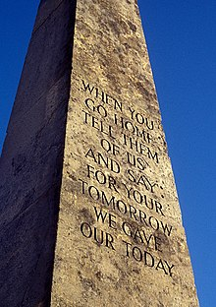
My poppy is for…
The contributions - and the sacrifices - made by ordinary men and women in wars throughout the ages. I don't see the poppy as a political symbol, nor is wearing one a patriotic or militaristic statement. Wearing a poppy is a simple act of remembrance and respect towards those who gave their lives for the benefit of others. There but for the grace of God go all of us. The writer John Maxwell Edmonds crystallised the sacrifices made in the following lines:
"When you go home, tell them of us and say, For your tomorrows these gave their today."
Mr Williams

Slide 13
My poppy is for…
All the young men and women who sacrificed so much at what should have been a pivotal and exciting point in their lives. I remember my grand-parents Bernard and Winnifred when I wear a poppy. They'd not long been together when my grandad was conscripted to WWII at the age of 19. He served as a motorcycle dispatch rider in Beirut in the Middle East. He survived a gun shot wound just above his hip which left him with lifelong pain and impacted his mobility and also suffered from what we now know as PTSD for much of his adult life. My Nan joined the Women's Land Army and served the war effort delivering milk. It wasn't until the early 2000s that the efforts of the women who had joined the Land Army were formally recognised and rewarded. My grand-parents were parted for 6 years during WWII and did not see one another at all during that time. They were eventually reunited and happily married in 1947.
Mrs Wilson

Slide 14
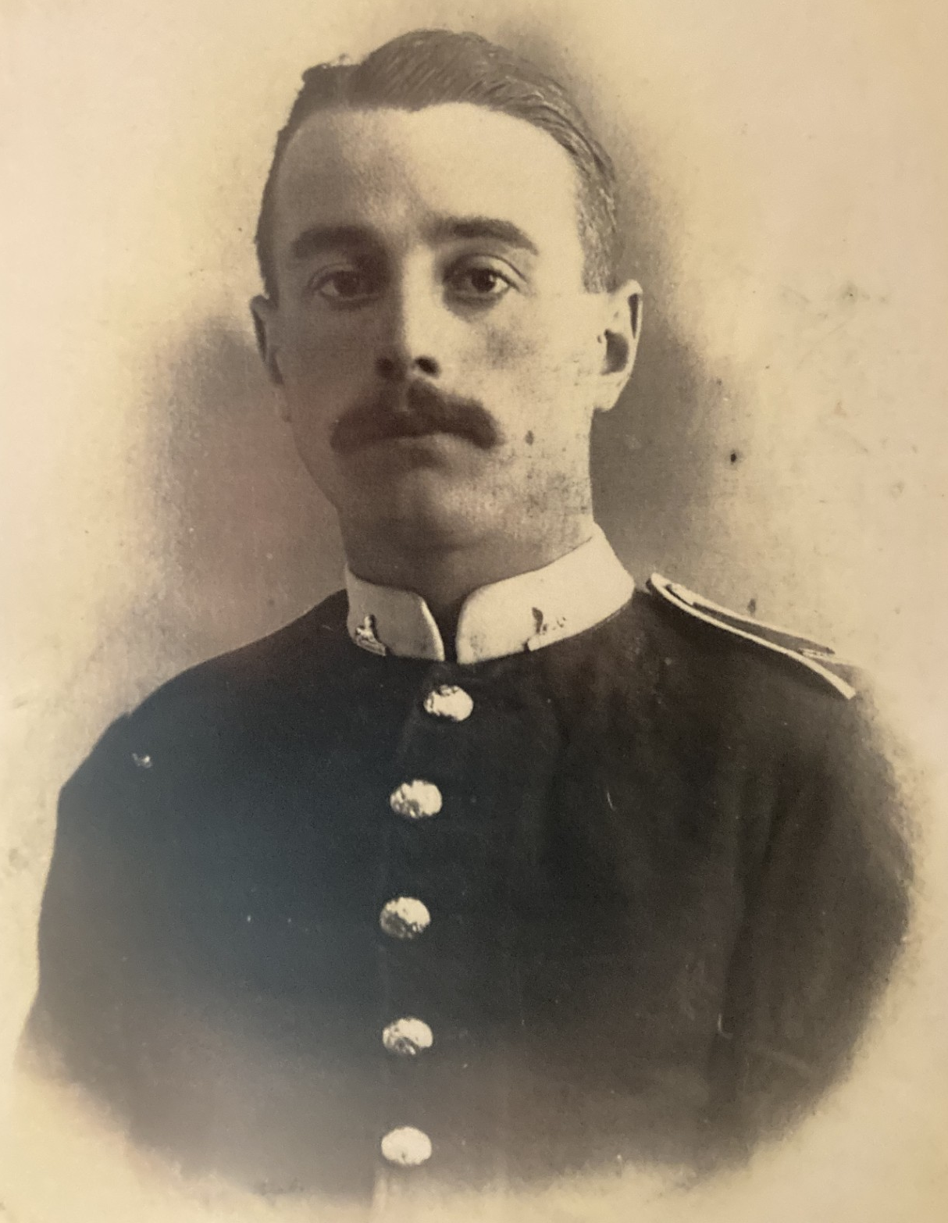
My poppy is for…
My husband’s Great-grandfather, Fred Baxter. He was stationed in India when war broke out and was sent to France by boat. He was a soldier before World War I broke out and part of the British Expeditionary Force. He fought in the trenches until he was injured by shrapnel after 6 months. He was sent home to hospital to recover and never returned due to the severity of his injuries.
Mrs Hoogenberg

Slide 15
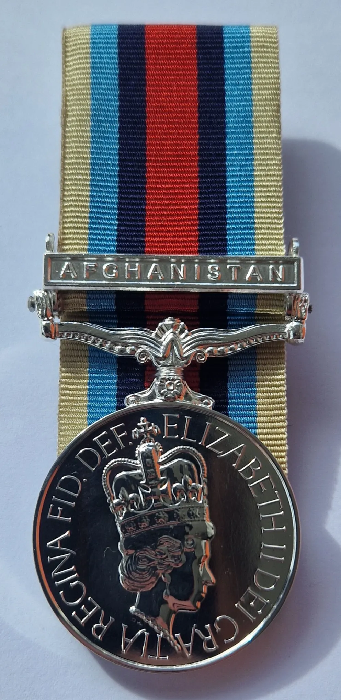
My poppy is for…
The fallen and wounded but especially in honour of my dad who is ex-military. Growing up he was deployed to Afghanistan and Iraq so I was always aware of the dangers he was putting himself in and he taught me a lot about history and the ways in which we show respect to those who fought in the past. His stories about Afghanistan and Iraq never contained any gruesome details, but I reflect a lot that he was in an active warzone, in danger much like those in 1914 and 1939. I wear my poppy as a symbol of respect to him, his friends that never came home and the mothers, brothers, sisters and friends throughout history that have died in service to their country.
Mr Gleave

Slide 16
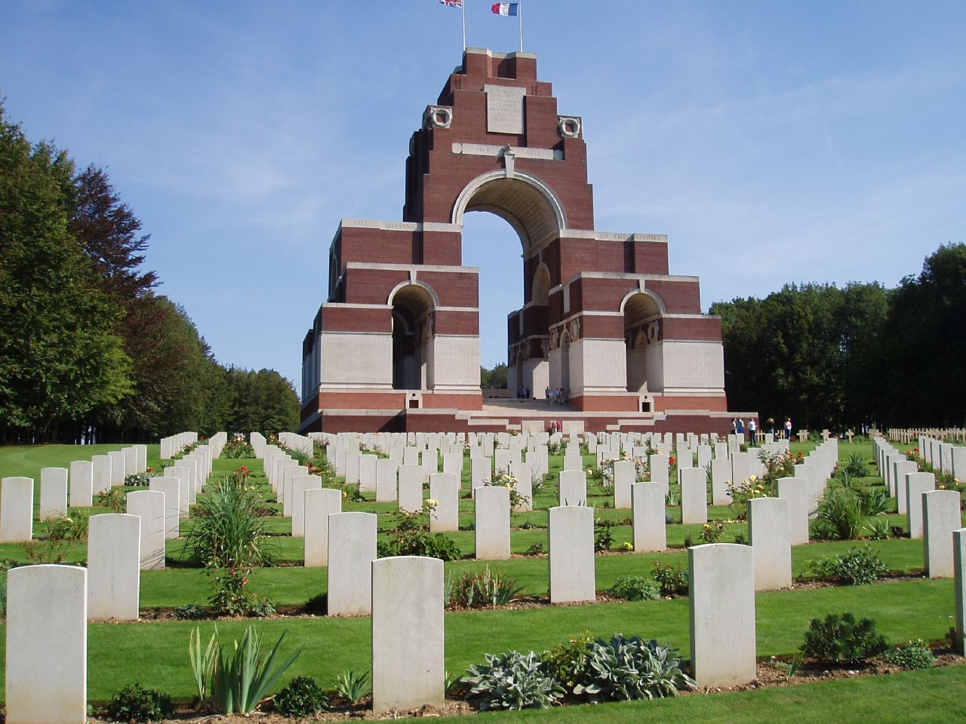
My poppy is for…
Those ordinary (mostly) men and in some cases boys, whose lives were cut short so tragically in the futile slog of trench warfare. Having visited The Battlefields on several occasions on school trips, I was struck by the sheer scale of the loss of life during WWI. The poppy reminds me that behind the thousands of gravestones or names on walls is a life story of someone who was a son, a friend, maybe a brother or a husband, even a father who lost their life in the senselessness of a war orchestrated by aristocrats that would never themselves see the horrors of WWI first-hand. At a time where the poppy has been hijacked for those who wish to engage in culture wars, it is vital to reflect on who, or what, we are remembering, and why. Mr Scott

Slide 17
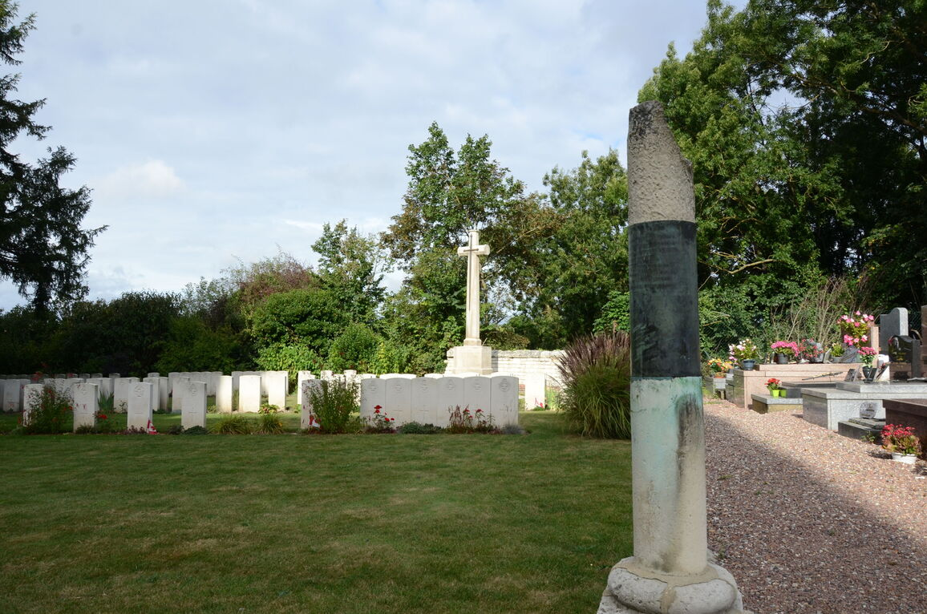
My poppy is for…
All those lost in the trenches of the Western Front. My daughter was born in Picardie, France which is where many of the WW1 battles were fought. When I drove in the region I could even see the altered and carved out earth. I would see the monuments to the fallen in even the smallest villages. The graveyards had English/American names as well as French. And of course my daughter, as a baby and toddler, loved the poppy fields. It’s just one of the many reasons I wear one every year. Mrs McCallin

