Slide 1
GCSE Preparations in Religion, Ethics & Philosophy
AQA key dates: Full Course exams: 9th May – Religions Paper. 16th May – Themes Paper. (Exam code: 8062 Religious Studies Full Course)
Short Course exam: 16th May (Exam code: 8061 Religious Studies Short Course)
Revision guides: These are £5 on parent pay – well worth the investment even at this late stage.
https://www.aqa.org.uk/subjects/religious-studies
Resources: Things that we can provide you with to boost your attainment and focus your revision.
Booster sessions: Masterclass sessions will run in the build up to your exams, keep an eye out for further details following the Easter break.

Slide 2
Below are the examined religious topics for the Short Course Exam.
Christianity Beliefs and teachings
Relationships and Families
Islamic Beliefs and Teachings
Peace and Conflict
1 hour and 45 minutes to answer each section of the exam.
NO element of choice.
Simple question and answer booklet.
Key skills: to explain and evaluate key religious and non-religious concepts.

Slide 3
Below are the examined religious topics for the Full Course Exam.
Paper 1: Religions
Christian Beliefs and Teachings
Islamic Beliefs and Teachings
Christian Practices
Islamic Practices
1 hour and 45 minutes to answer each section of the exam.
NO element of choice.
Simple question and answer booklet.
Key skills: to explain and evaluate key religious and non-religious concepts.
Paper 2: Themes
Relationships and Families
Peace and Conflict
Crime and Punishment
Religion and Life
1 hour and 45 minutes to answer each section of the exam.
NO element of choice.
Question booklet and separate answer booklet.
Key skills: to explain and evaluate key religious and non-religious concepts.

Slide 4
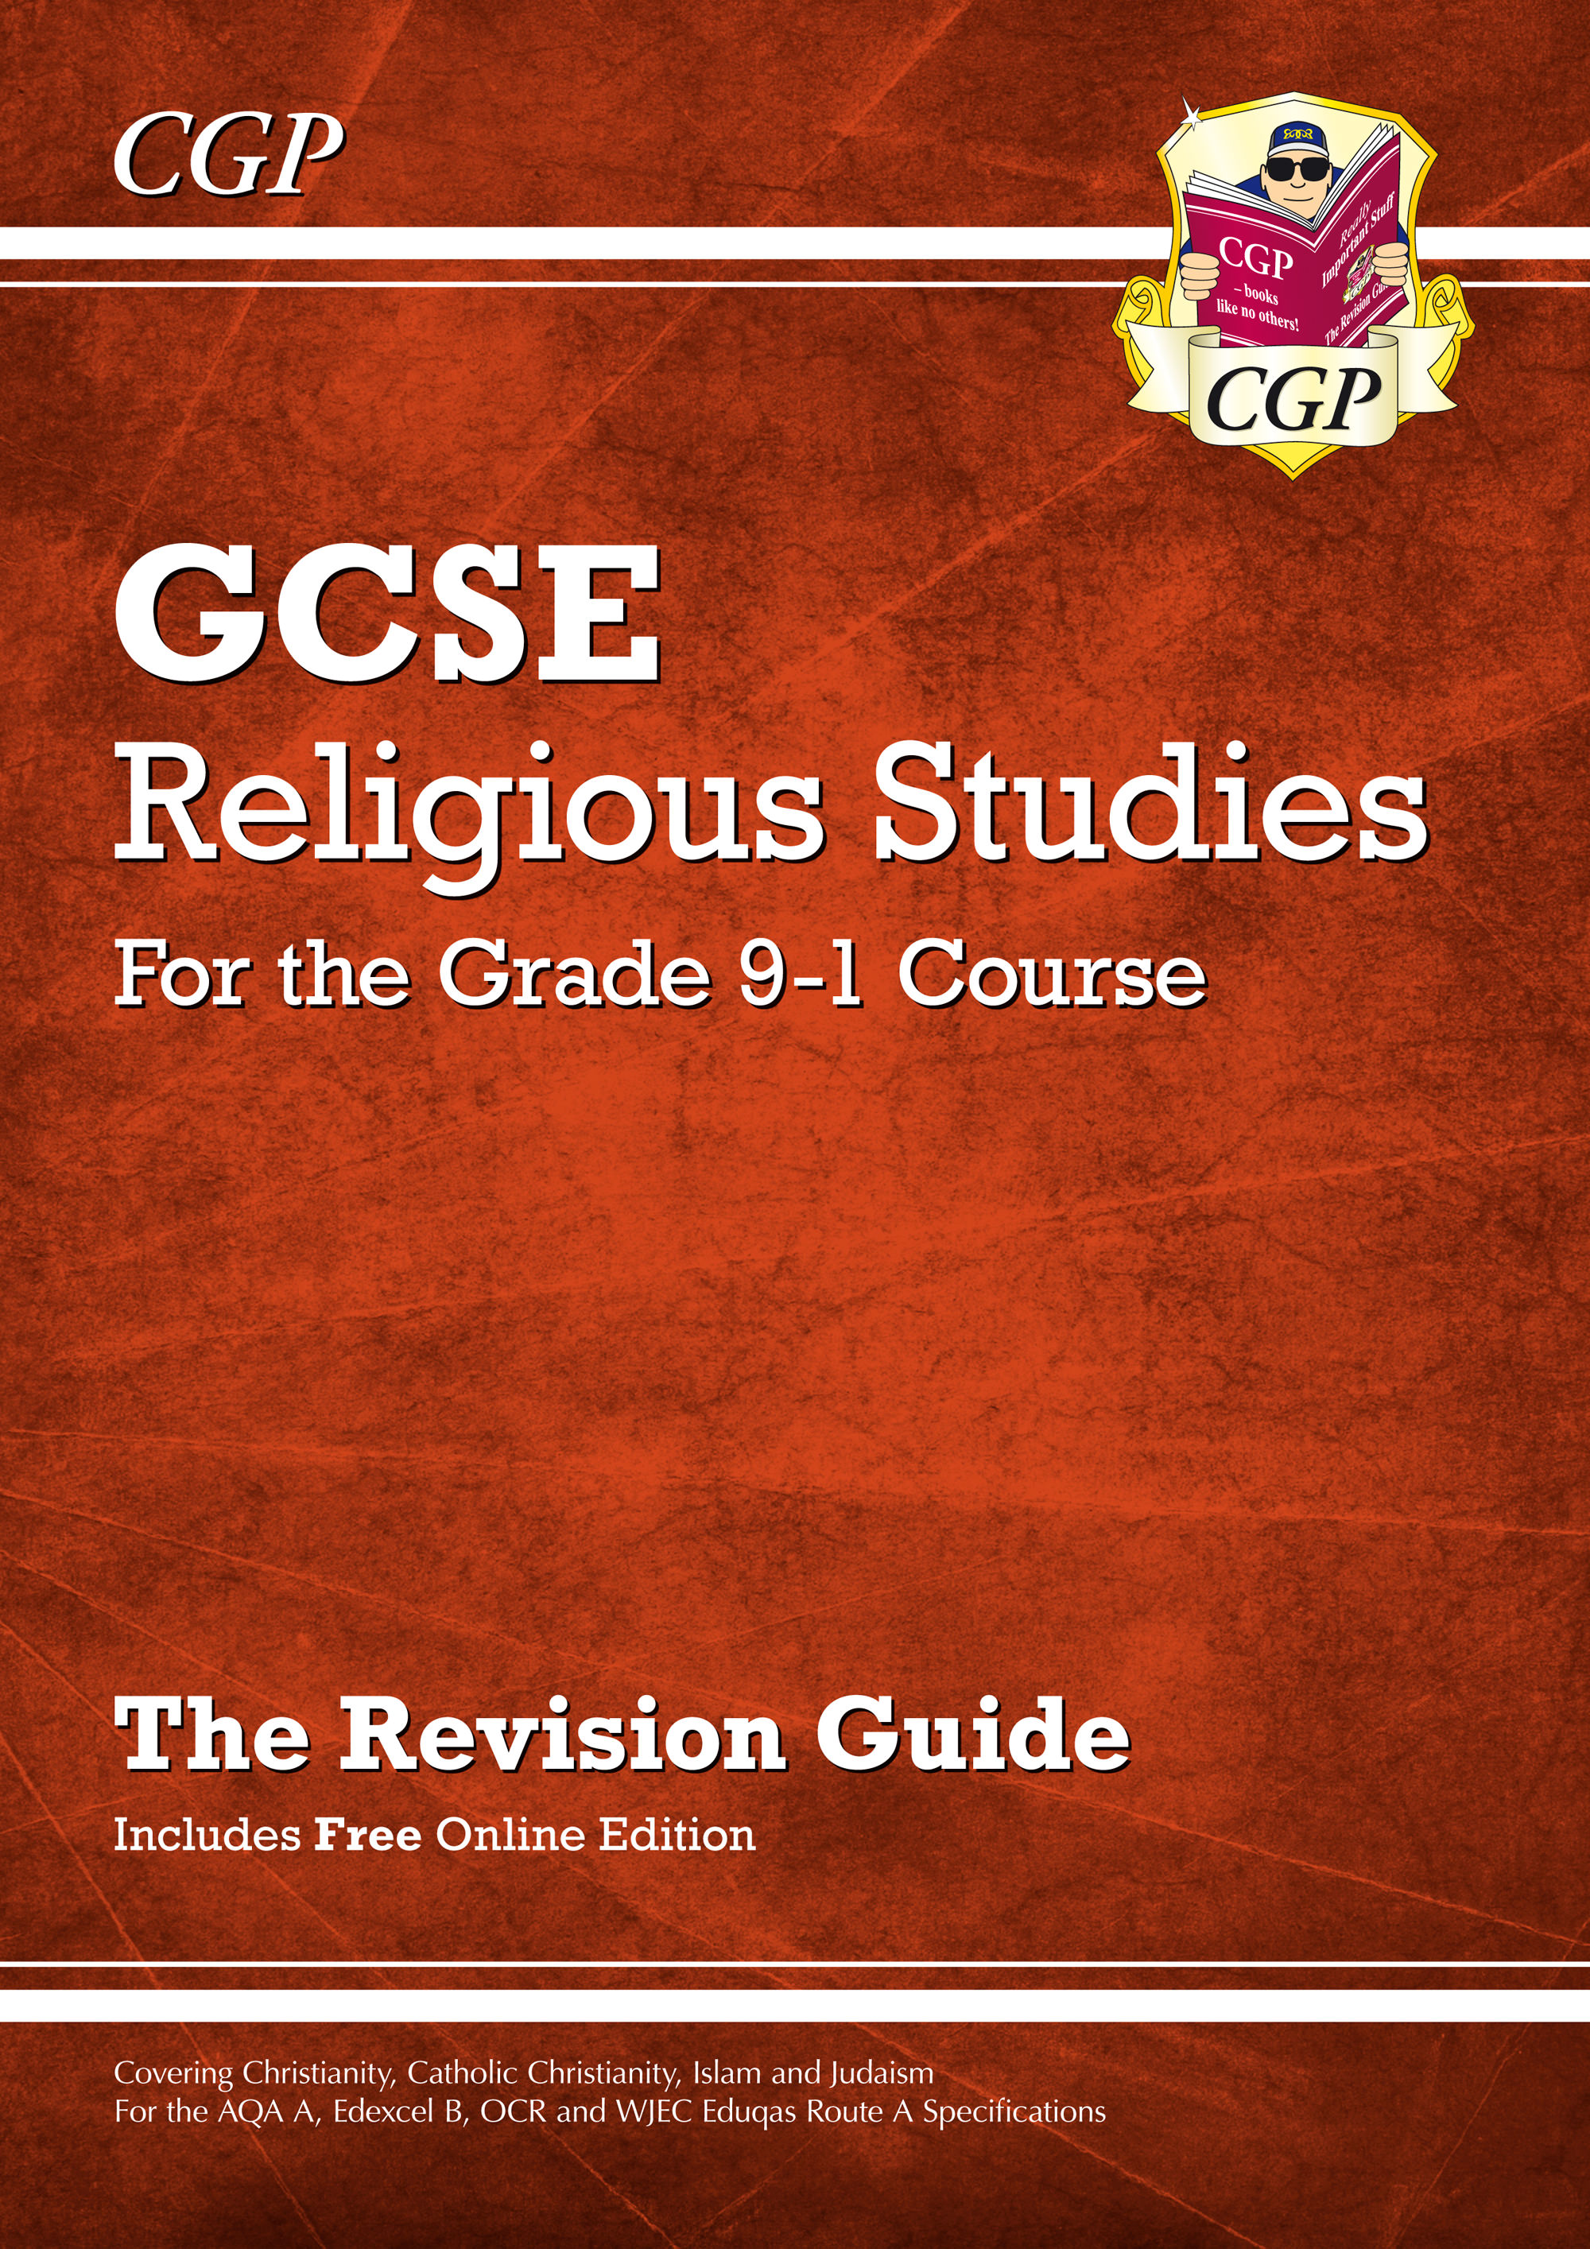
Revision Guide These include all the content that you will need to revise for your exam. They also contain example questions and will help you prepare with your exam technique. Come and buy one from Mr Harrison directly or they are on parent pay.

Slide 5
Resources & Booster Sessions Work packs: Complete these to check your understanding of key areas. Previous papers: accessible on the AQA website: https://www.aqa.org.uk/subjects/religious-studies QR Revision clips: these will be posted to you on ClassCharts in advance of your exam and can be found in the revision guide the department has made for you. You can get these from your teacher as well. Your exercise books, particularly the A3 review documents you have been completing, are important for revision Your teacher – go and ask for help at any time. We will also run masterclass and booster sessions in the build up to the exams.

