Slide 1


GCSE Food Preparation and Nutrition
Examination Advice & Revision Tips

Slide 2
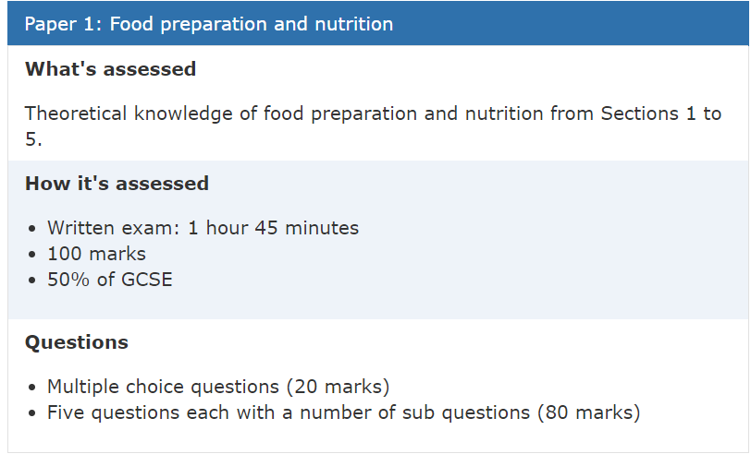
EXAMINATION DATE
Wednesday 19th June 2024

Slide 3

Section A – Multiple Choice
Section A is multiple choice questions worth 20 marks and students will be expected to answer questions on the following 5 categories:
Food, nutrition and health, Food Science, Food Safety, Food Choice and Food Provenance.
To maximise marks in this section read the questions carefully highlight keywords and always use the process of elimination when unsure.
Useful online revision resources
www.senecalearning.com an online revision platform where students can revise topics, complete tests and receive instant.
GCSE Bitesize
https://www.bbc.co.uk/teach/class-clips-video/design-and-technology-gcse-food-preparation-and-nutrition/zvjh8xs watch the video’s and make notes.f

Slide 4
Section B
Section B – Five questions, each with a number of sub questions (80 marks)
This section assesses knowledge on the five categories tested in section A (Food, nutrition and health, Food Science, Food Safety, Food Choice and Food Provenance). However this time more in-depth knowledge is required and students must read questions carefully to ensure they are actually answering the question and not just writing down anything they know.
There will be a mixture of question types including some short answer questions (2 – 4 marks), some questions where data is given and students must refer to this in their answer and some extended response questions which also test quality of written communication (6 – 12) marks.
TIP: Include subject specific terminology in your responses this demonstrates a good understanding of the subject. Also use the mark scheme to help you plan your answer e.g. if it is worth 8 marks you could make 4 key points (1 mark each) and justify/explain them (1 mark for each justification/explanation).

Slide 5
Revision
GENERAL REVISION TIPS
Re-reading lesson notes to clarify knowledge & understanding of what has been taught in lessons. This must be done after each lesson to identify gaps in their knowledge. And anything they don’t understand, ask their subject teacher to revisit in lessons!
Glossary of key words and terms is vital, revise the meanings is also useful.
Revision guides created by your subject teacher for the mocks completed. Read through theses again and highlight the key information.
RAG rating their knowledge of topics for each section of the exam – evaluating what they know and what areas they need to focus their revision! Use the checklist you have been given so you can do this.
Complete past papers, practise exam technique including timed conditions.

