Slide 1
Vcert Engineering
Examination Advice & Revision Tips

Slide 2
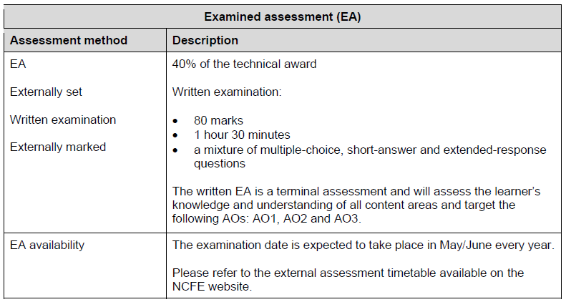
EXAMINATION DATE
Friday 7th June 2024

Slide 3
TYPES OF QUESTIONS

Slide 4
ASSESSMENT MATERIALS

Slide 5
GENERAL REVISION TIPS
Re-reading lesson notes to clarify knowledge & understanding of what has been taught in lessons. This must be done after each lesson to identify gaps in their knowledge.
Revision guides, these are graphic knowledge organisers these have been created by subject teachers. Read through the topics highlight the key information.
RAG rating your knowledge of topics for each section of the exam – evaluating what they know and what areas they need to focus your revision!
Complete past papers, practise exam technique including timed conditions.

