Slide 1
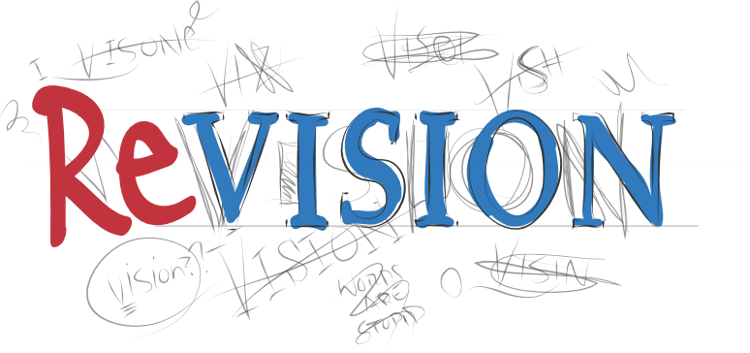
Supporting students with revision
Knowing what you need to revise
Break revision down into small steps
Retrieval
Use of visuals
Creating a narrative
Decoding exam questions
Making connections and categorising
Using key course vocabulary

Slide 2
1. Knowing what you need to revise
The first step when it comes to revision is knowing what you need to revise.
Your teachers should have provided you with a PLC or checklist with the topics on.
If you do not have a checklist of the different topics / units that are going to be on your exam, then you need to get one from that member of staff.

Slide 3
2. Break revision down into small steps
There is no way that you will be able to revise everything all at once.
Using your checklist, break down the topics that you need to revise and select the areas that you are least confident about first.
Then dedicate a period of time to go over a particular area using some of the methods in this PowerPoint.

Slide 4
3. Retrieval
Retrieval is key!
Retrieval means to recall or remember information.
There are so many ways that students can retrieve information, even during a short period of independent study:
Completing past papers
Reproducing study notes or mind maps from memory
Reading through previous essays and adding additional details without using notes
Creating a list of questions and writing model answers
Spending ten minutes writing out the key words for a topic
Brain dumps: putting pen to paper and writing as much as they can on a topic for 5 minutes

Slide 5
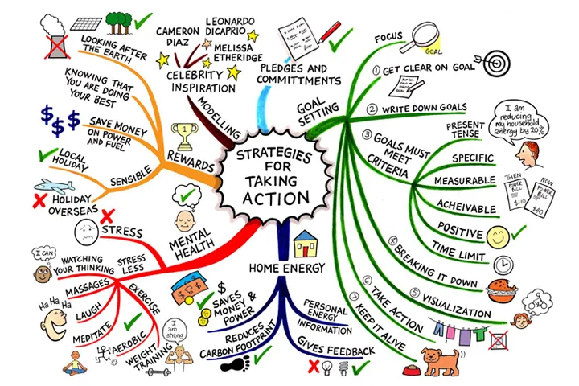
4. Use of visuals
Using images to help support memory is a proven revision method.
Associating pictures with words/topics helps you to remember key information.
Strategies such as:
Mind maps
Spider diagrams
Storyboards
Drawing images next to key pieces of information

Slide 6
5. Creating a narrative
If you can attach a hook to something, you are more likely to remember it. A great way of doing this is to create a narrative around the topic.
All this means is that you can link the topics you are studying to a story, scenario or conversation.
Try to link parts of your subject knowledge together to create a narrative or a story about it.
For example you could create a story/rhyme to remember the order of events or a process.

Slide 7
6. Decoding exam questions
You have done all of the topics in the exam but sometimes the questions can make us panic because of the way that they are worded.
Sometimes you need to decode the question and think about what it is actually asking you to do or discuss.
You should highlight key parts of the question
Practise rewriting exam questions in a simplified way
Annotate exam questions with key points

Slide 8
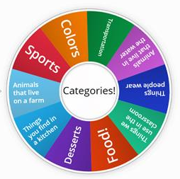
7. Making connections and categorising
Making connections within your revision is important.
Different parts of the subject/topic may connect together which can make revision easier and also help you to remember content.
Look at your checklist/PLC and colour code similar parts of the subject/topic and use that to organise your revision.
Categorising different areas of the subject will also allow you to focus your revision on specific areas and break it down into manageable chunks.

Slide 9
8. Using key course vocabulary
If you have not got one already you should get/create a word bank of key words from your subject.
Make sure you have the definitions for these words and know what they mean.
Then you need to practise using those words. It is not enough to just know what they mean, sometimes you need to practise using them in questions.
Write sentences or a paragraph with some of the words in and highlight them when you have used them
Get practise questions from your teacher and highlight each time you have used a key word in your answer
Write a short story using some of the key words from your course

Slide 10
A list of different strategies
Not every strategy will work for every subject or every student but below is a list of different revision techniques that could be used:
Completing past papers
Reproducing study notes or mind maps from memory
Reading through previous work/assessments and adding additional details without using notes
Creating a list of questions and writing model answers
Spending ten minutes writing out the key words for a topic
Brain dumps: putting pen to paper and writing as much as they can on a topic for 5 minutes
Flashcards
Categorising
Writing a 10 question quiz
Working with a partner to write quizzes for each other
Create a key word and definition sheet
Create some mnemonics to help you to remember key phrases or steps

