Slide 1


Wellington School
GCSE Maths Revision
2023
Mr. W. Riley
Head of Maths

Slide 2
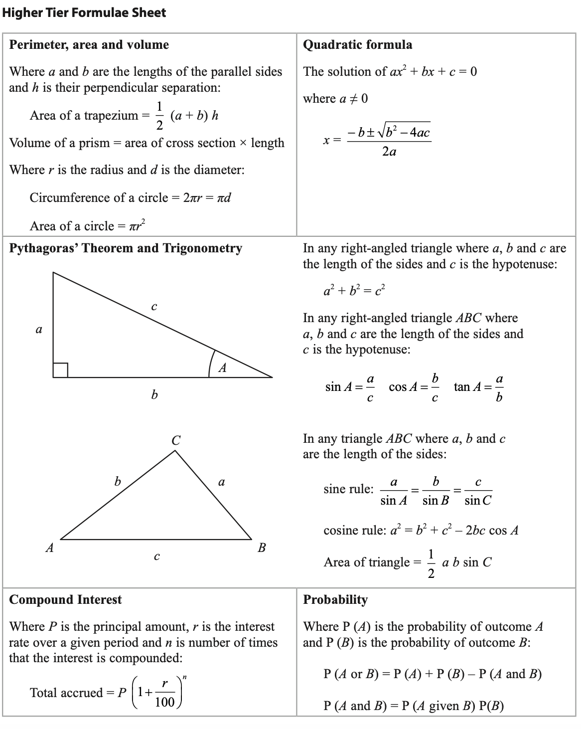
Exam Board – Edexcel (Pearson)
Higher Tier (Grades 3 - 9)
Foundation Tier (Grades 1 - 5)
Paper 1 – Non-Calculator
80 marks
90 mins
Friday 19th May (Morning)
Paper 2 – Calculator
80 marks
90 mins
Tuesday 6th June (Morning)
Paper 3 – Calculator
80 marks
90 mins
Wednesday 14th June (Morning)
Formula Sheet:
EXAM
INFORMATION
Wellington School
GCSE Maths Revision
2023

Slide 3
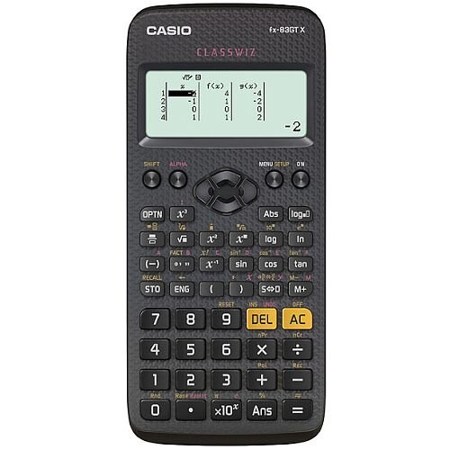
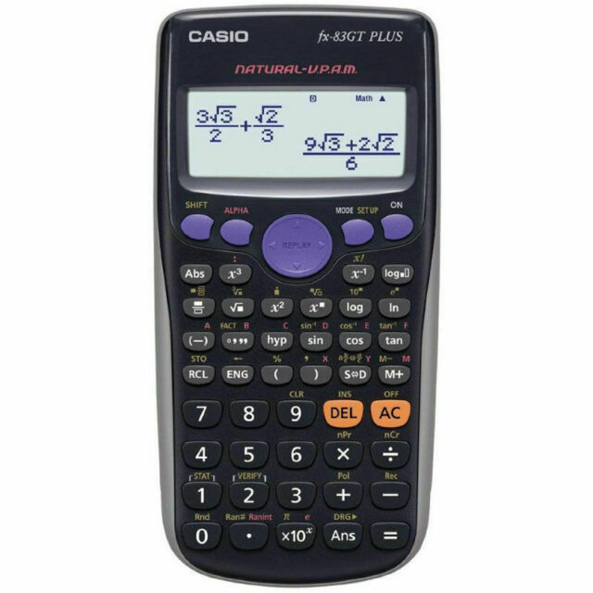
Pen
Pencil
Ruler
Geometry Equipment (compasses and protractor)
Scientific calculator
  Casio FX83-GT range
REQUIRED
EQUIPMENT
Wellington School
GCSE Maths Revision
2023

Slide 4
PRACTICE, PRACTICE AND MORE PRACTICE…
  Topic Specific Revision
  Exam Practice
Edexcel
Complete online using MethodMaths or
papers available with mark schemes and video walkthroughs on Maths Genie
Do a practice paper
Identify weaknesses
Work on the weakness
Practice exam questions on the weaknesses
Keep a revision checklist
HOW TO
REVISE MATHS
Exam questions by topic on MathsGenie and MathedUp
Revision guide, Hegarty Maths, Corbett Maths
Wellington School
GCSE Maths Revision
2023

Slide 5
Revision Sessions
Teacher | Grade Target | Time
AHN | Grade 8-9 | Wednesday after school (until mocks)
AHN | Grade 7+ | Wednesday after school (after mocks)
ARN | Grades 5 - 7 | Monday after school
ETS | Grade 6 - 7+ | Wednesday after school
RGN | Grades 5 - 7 | Wednesday after school
SCW | Grade 3 - 5 | Monday lunchtimes
WRY | H/F crossover Grade 5+ | Wednesday after school
WRY | H/F crossover Grade 5+ | Monday lunchtimes
EXTRA SUPPORT
IN SCHOOL
Wellington School
GCSE Maths Revision
2023

Slide 6
Edexcel (Past Papers and Mark Schemes)
Method Maths (Online Exam Papers)
  methodmaths.com
Hegarty Maths (Topic Specific Tutorials and Quizzes)
  hegartymaths.com
Maths Genie (Exam Style Questions on Every Topic)
  mathsgenie.co.uk
Mathed Up (Exam Style Questions on Every Topic)
  mathedup.co.uk
Corbett Maths (Practice Questions by Topic)
  corbettmaths.com
USEFUL
WEBSITES
Wellington School
GCSE Maths Revision
2023

