Slide 1
Wellington School
GCSE Maths Revision
2022
Mr. W. Riley
Head of Maths

Slide 2
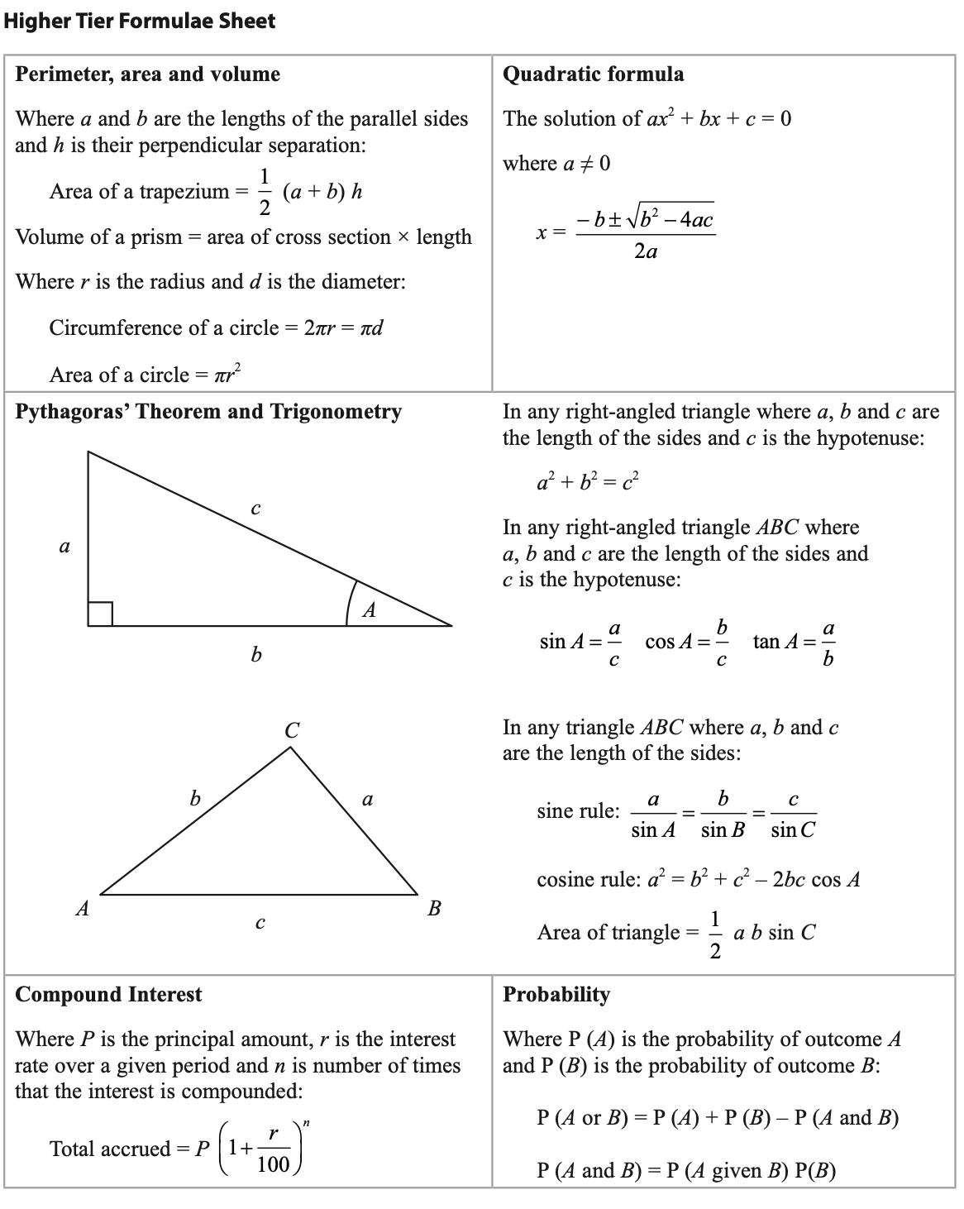
Exam Board – Edexcel (Pearson)
Higher Tier (Grades 3 - 9)
Foundation Tier (Grades 1 - 5)
Paper 1 – Non-Calculator
80 marks
90 mins
Friday 20th May (Morning)
Paper 2 – Calculator
80 marks
90 mins
Tuesday 7th June (Morning)
Paper 3 – Calculator
80 marks
90 mins
Monday 13th June (Morning)
Formula Sheet:
EXAM
INFORMATION
Wellington School
GCSE Maths Revision
2022

Slide 3
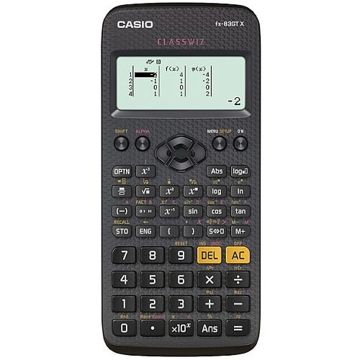
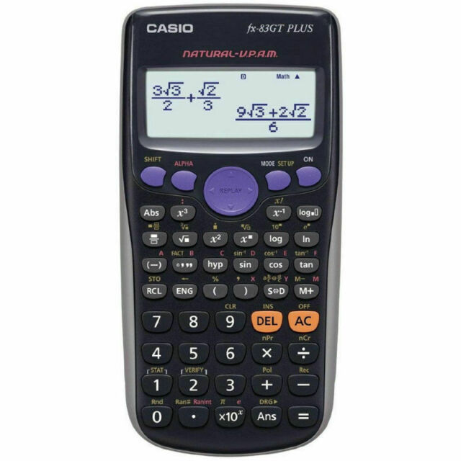
Pen
Pencil
Ruler
Geometry Equipment (compasses and protractor)
Scientific calculator
Casio FX83-GT range
REQUIRED
EQUIPMENT
Wellington School
GCSE Maths Revision
2022

Slide 4
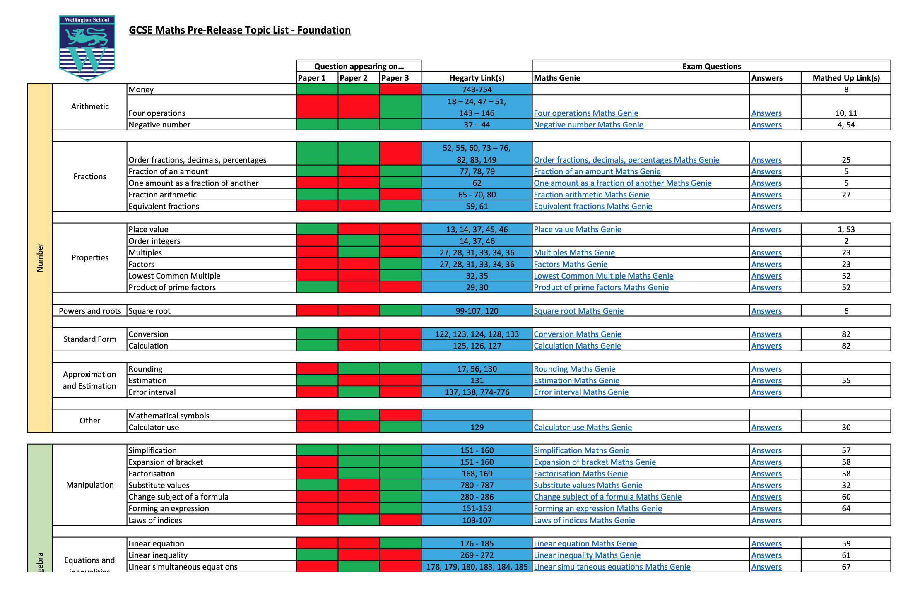
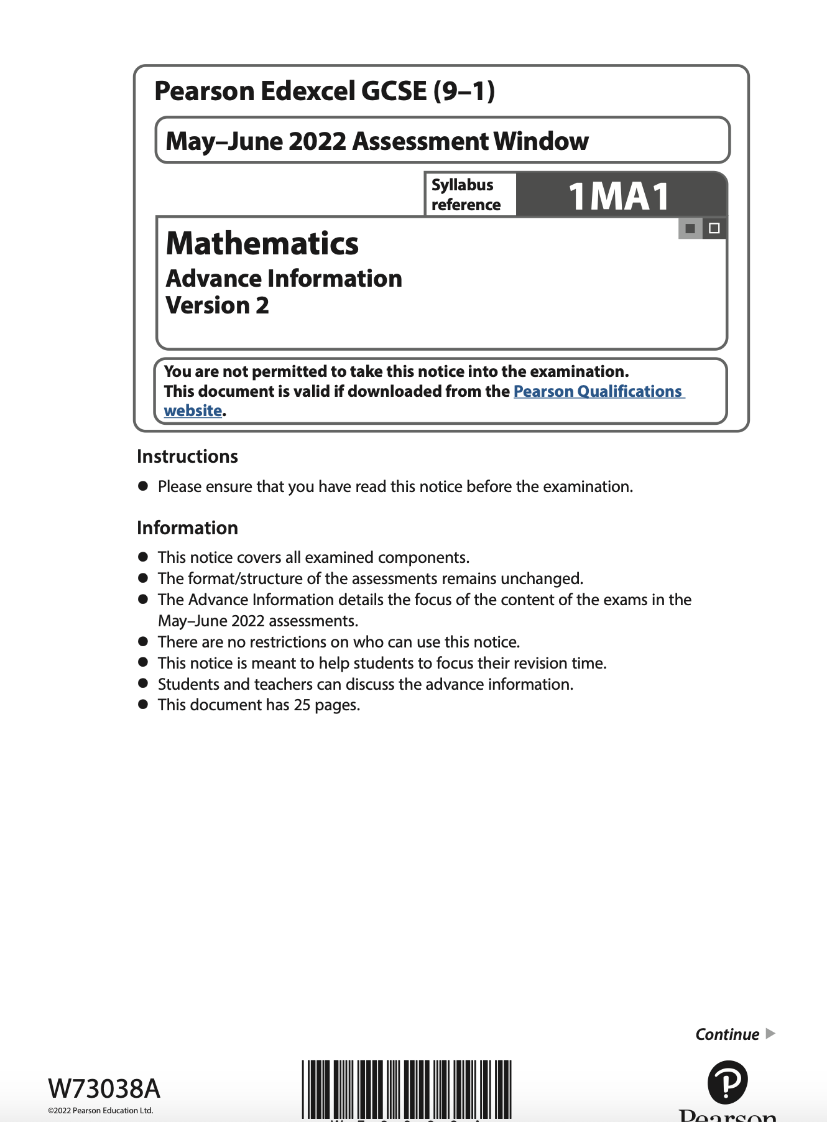
Topics listed by paper
Pearson Edexcel Website
Wellington produced Topic List with links to revision resources
Use to structure revision
Prioritise Topics
PRE-RELEASE
INFORMTAION
Wellington School
GCSE Maths Revision
2022

Slide 5
PRACTICE, PRACTICE AND MORE PRACTICE…
Topic Specific Revision
Exam Practice
Revision Sessions
Higher Tier – Mr. Riley (Tuesday)
Foundation Tier – Mr. Rispin (Wednesday)
HOW TO
REVISE MATHS
Wellington School
GCSE Maths Revision
2022

Slide 6
Edexcel (Past Papers and Mark Schemes)
Method Maths (Online Exam Papers)
methodmaths.com
Hegarty Maths (Topic Specific Tutorials and Quizzes)
hegartymaths.com
Maths Genie (Exam Style Questions on Every Topic)
mathsgenie.co.uk
Mathed Up (Exam Style Questions on Every Topic)
mathedup.co.uk
Corbett Maths (2022 Exams Practice Questions)
corbettmaths.com
USEFUL
WEBSITES
Wellington School
GCSE Maths Revision
2022

