Slide 2
Can I touch your hair?
(hand already extended)
Is that a perm/natural?
You only wash it once a week!?
That’s not a natural hair style, its against the rules
That’s a cool hairstyle, I would love braids…
Your hair is too big
You’ve had it cut too short
Sorry we don’t cut Afro hair here
(or we will have to charge you more)
Imagine breaking the rules, just by existing…….

Slide 3
The Halo Hair code
During the Anti-racism Ambassador training last year, it was raised in nearly every session that students with afro-textured hair or who wear protective hairstyles, like braids, cornrows often get unwanted verbal and physical attention
As a result, the Halo Focus group was formed to discuss the issues students face at Wellington school
Wellington school has now signed up to the Halo Code, which protects people with afro hair and their protective hairstyles.

Slide 4
Hair discrimination we face….
It’s hard at a school like Wellington when afro-hair is a minority hair texture
We often get people touching our hair, putting objects in our hair as a “joke”
It costs more to get afro hair cut/styled (many of us have to travel far to get someone who is specially trained). It takes a lot of care to keep it healthy.
Some of us wear our hair naturally, some have it cut short to help maintain and other wear protective hairstyles like braids. This is not a fashion statement, it is necessary and has strong roots in black identity

Slide 5
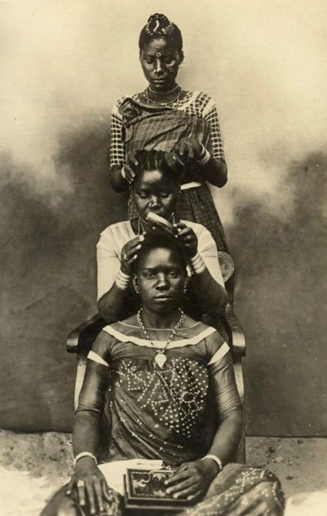
A history of hair discrimination…..
Afro-textured hair and hairstyles have always been an important symbol of wealth, identity, family, heritage, age, tribe, religion, and social rank, as well as a visual language.
Hairstyling was a meaningful social activity, where bonds were built and knowledge was shared within communities.
Connection to these traditions almost destroyed by the transatlantic slave trade.

Slide 6
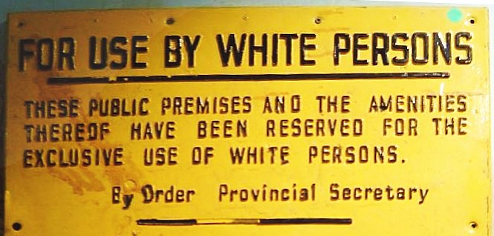
A history of hair discrimination…..
European slave traders classified Afro-textured hair as closer to fur or wool.
By using animal terms for black hair, it dehumanised the slaves, slave traders regularly shaved the heads of slaves, stripping them of their identity
Negative attitudes towards natural Black hair continued after the abolition of slavery.
During Apartheid, Black South Africans were forced to participate in "The Pencil Test" to see if they could hold a pencil in their hair while they shook their head. If the pencil did not drop to the floor, the person would be classified as black and subjected to segregation.
While these tests faded out of use, hair discrimination did not.

Slide 7
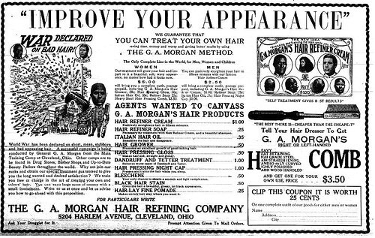
A history of hair discrimination…..
Global definitions of beauty have long been linked to “whiteness”
As a result, Black people began to use hot combs and harsh chemicals to straighten or “tame” hair in ways that mimicked European textures.
Straighter hair and looser curls was seen with “good hair” and necessary for accessing jobs, and natural texture hair was messy , unacceptable, and unprofessional.
These racist beauty standards were normalised around the world and still remain in place today.

Slide 8
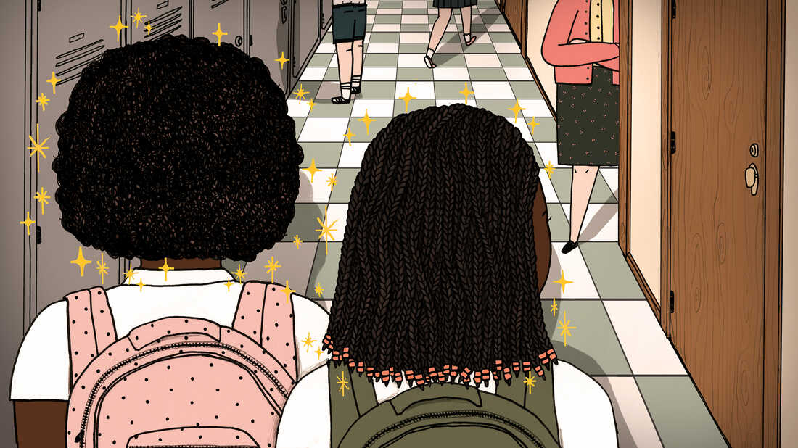
What we would like to happen:
As young people at Wellington School we do not want be defined just by our skin colour or our hair.
Be aware of the prejudice and the unwanted attention we get around our hair and intervene if you see it happening- call it out!
By all means ask questions- but think before you speak and please don’t touch!

Slide 9
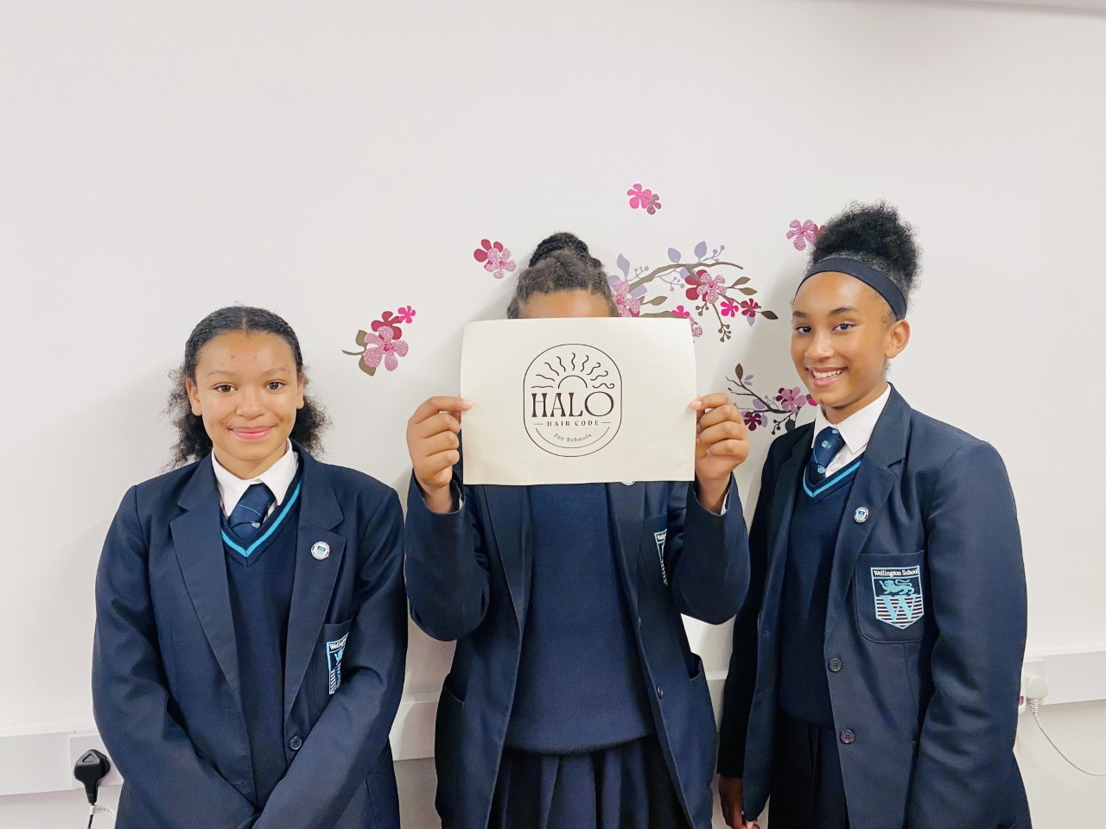
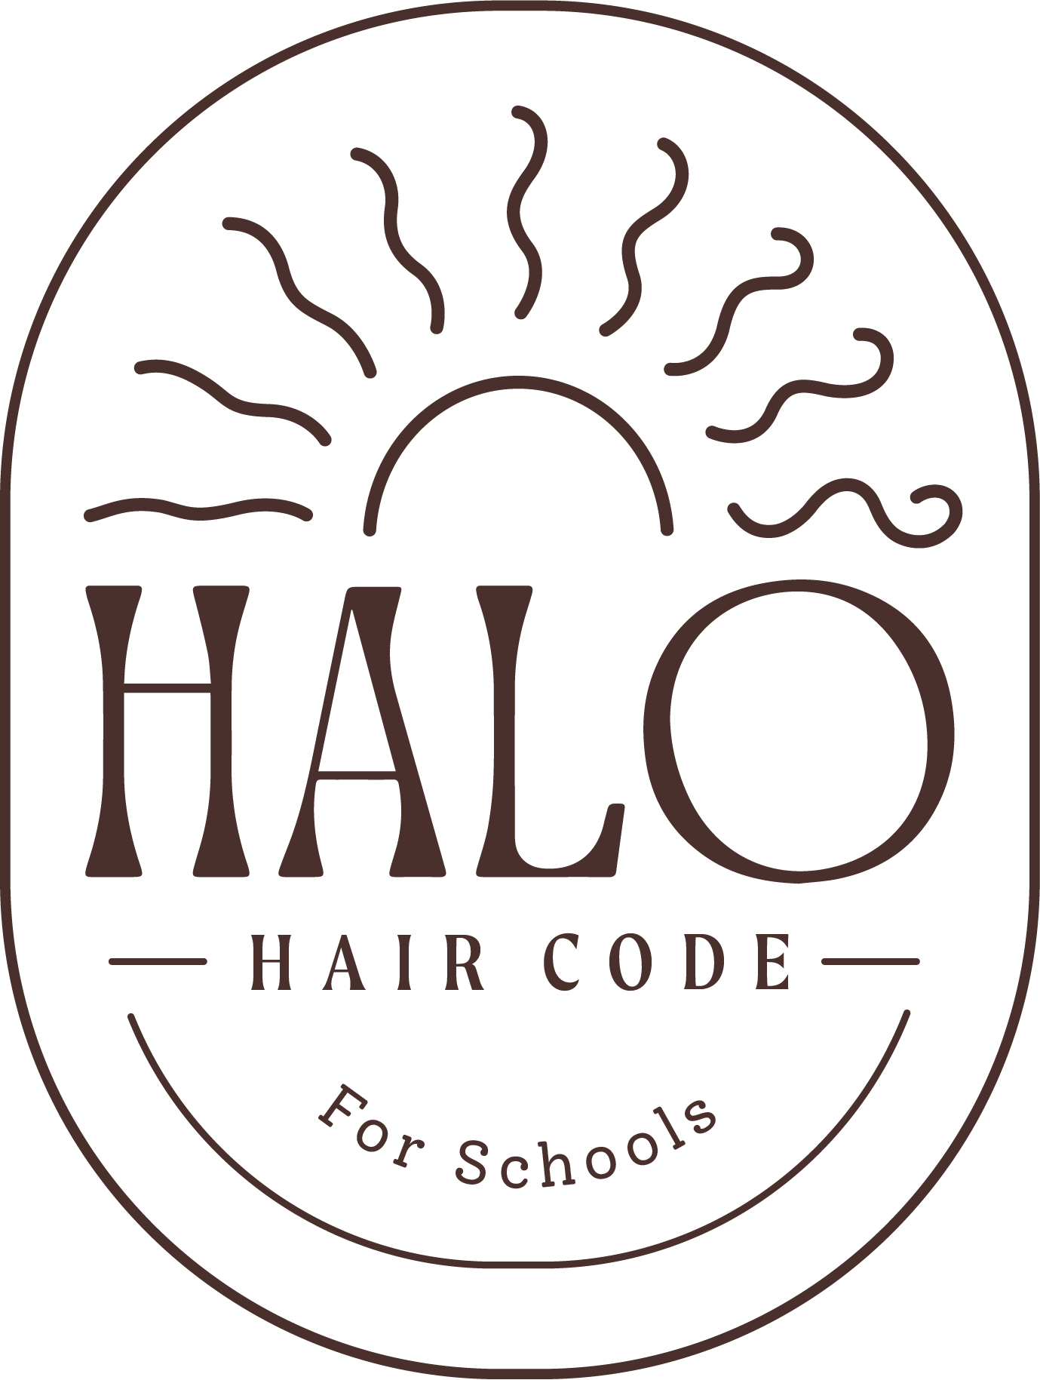
Thank you for listening!

